Slide 1
Unity Hall
Holy Family Catholic Church
Davidsonville, MD

Slide 2
Welcome to Unity Hall at Holy Family Catholic Church
Beautiful, neutral venue
Modern kitchen
Restrooms
Handicapped access
Over 200 Event Parking spaces
Wi-Fi available

Slide 3
Unity Hall Floor Plan
Easily create your space using our floor plan.
Room divider drops from ceiling (see - - - line).

Slide 4
Hall Rental Options
Entire Hall – for events from 150 guests to 300 sitting down. Rental space includes lobby and terrace.
Entire Hall – for events up to 700 standing or with limited seating.
2/3 Hall – for events up to 150 guests. Rental space includes lobby and terrace.
1/3 Hall – for events up to 80 guests. Rental space includes lobby.

Slide 5
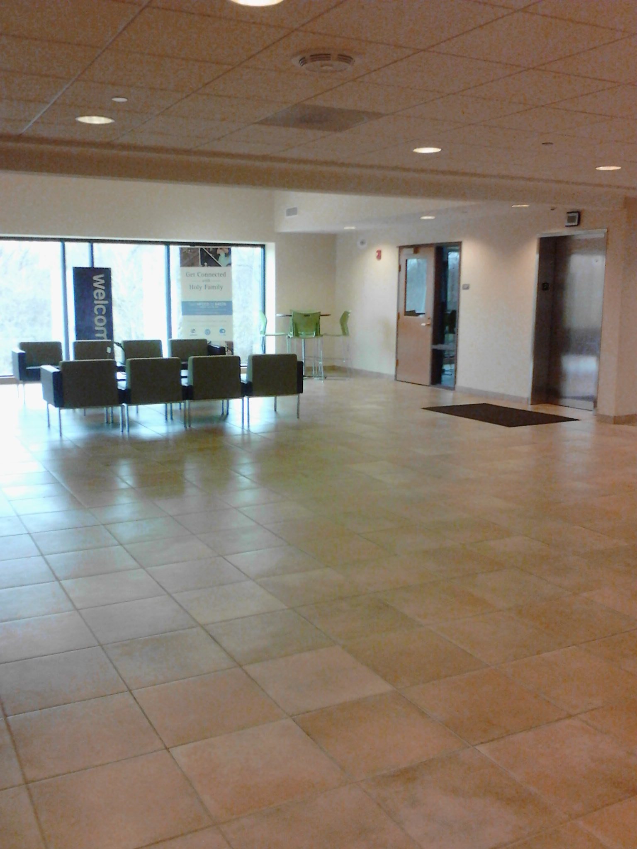
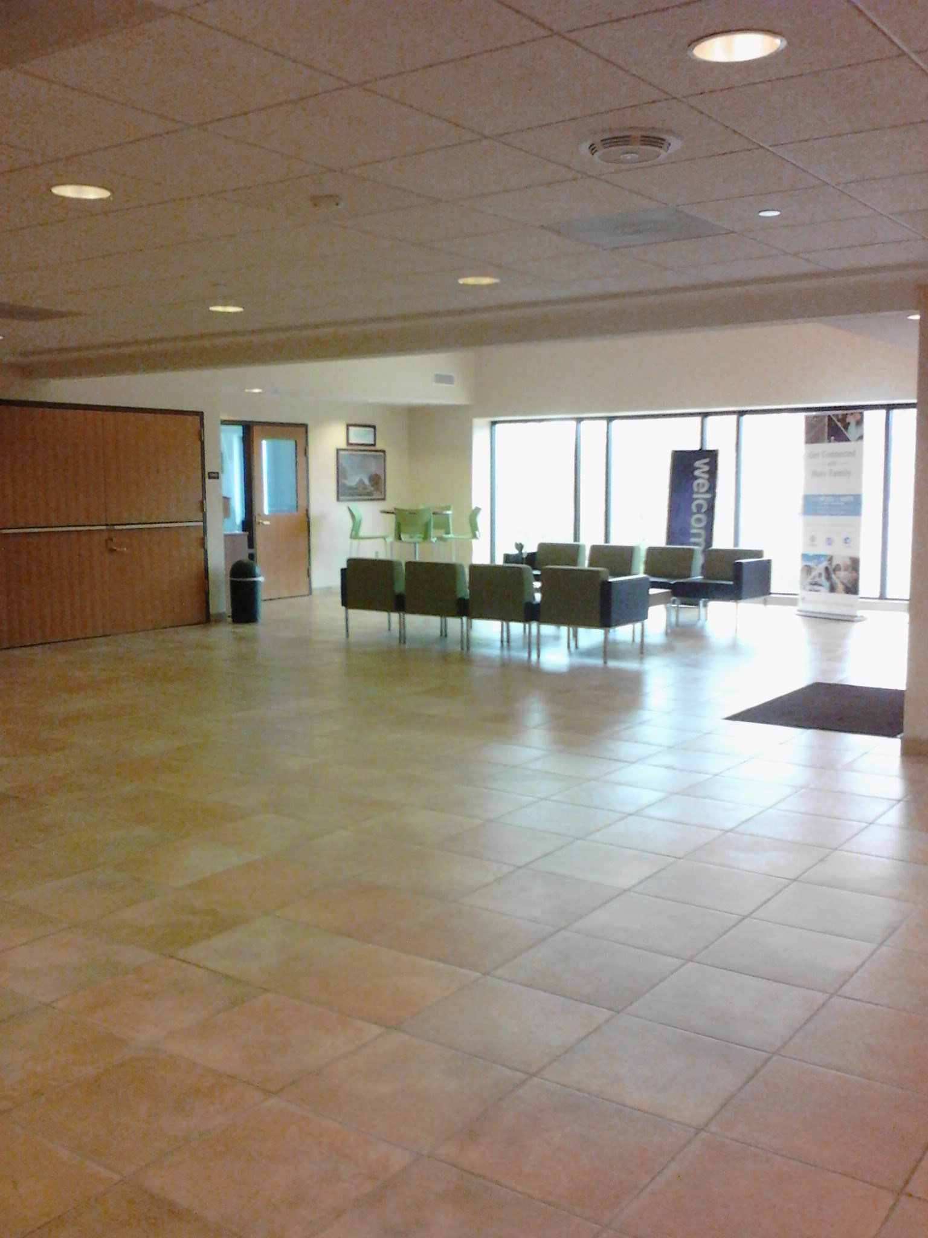
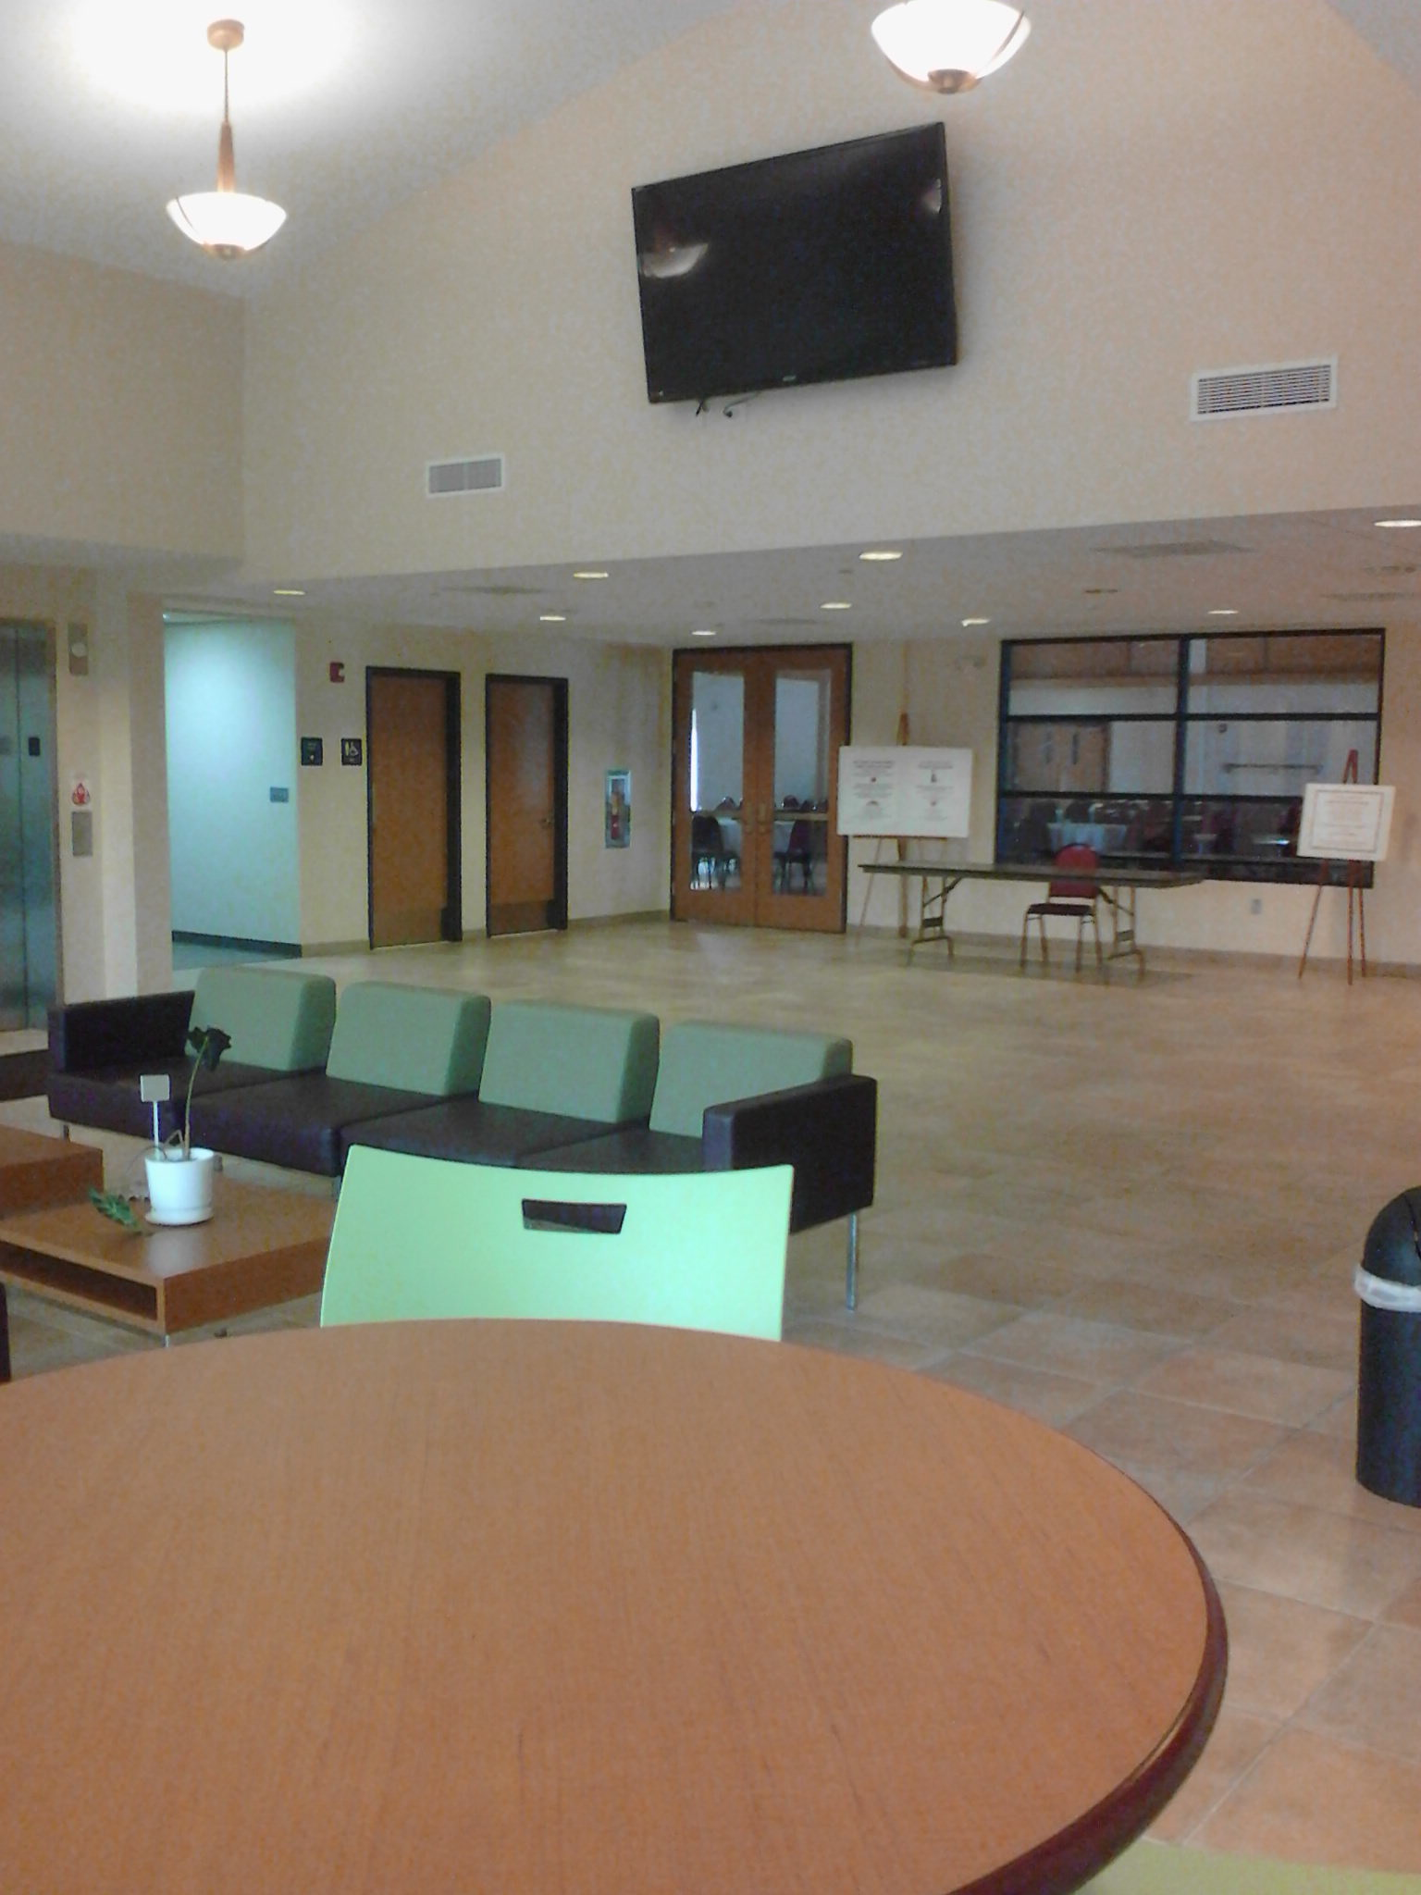
JMJ Café Lobby
Adequate space – 45’ x 25’ for greeting guests whether for registration, table assignments, cocktails and appetizers, or just a quiet space to relax.

Slide 6
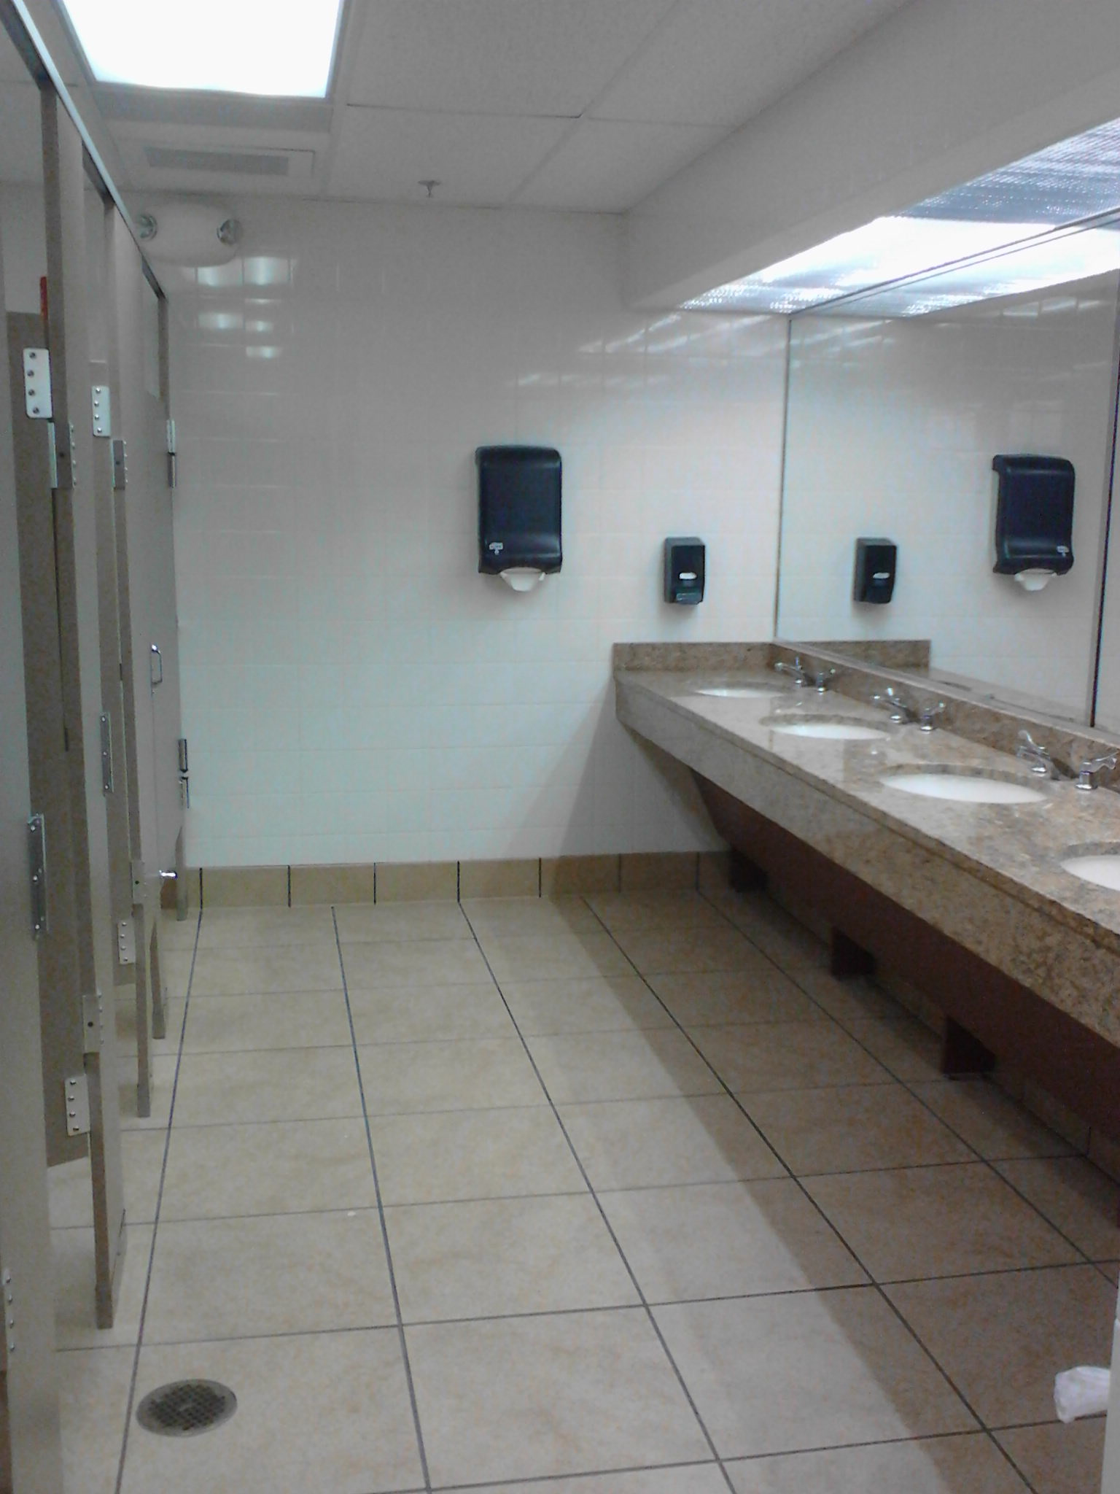
Restrooms
Large restrooms with 6 stalls in the women’s room and men’s room.
Neutral stone counter tops.

Slide 7
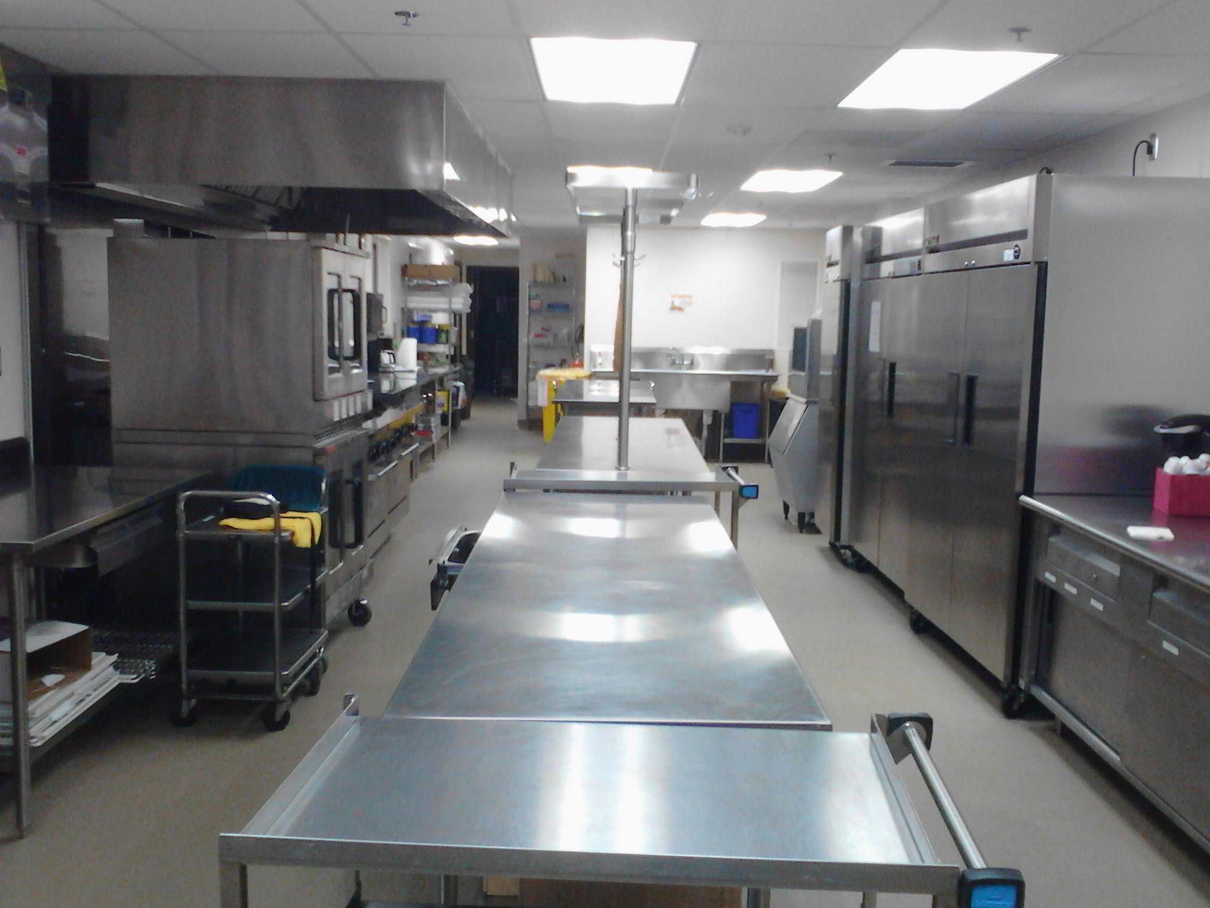
Unity Hall Kitchen
A Chef’s dream – 8 burner gas stove with 2 ovens
Large gas griddle
2 gas warming convection ovens
Unlimited ice machine

Slide 8
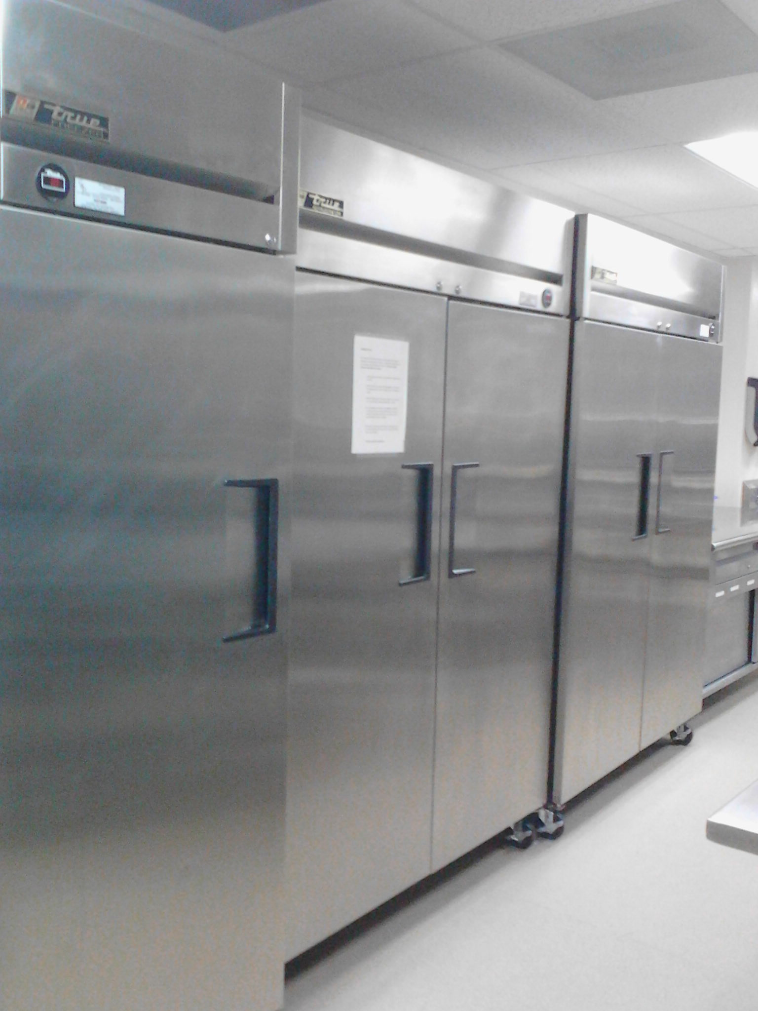
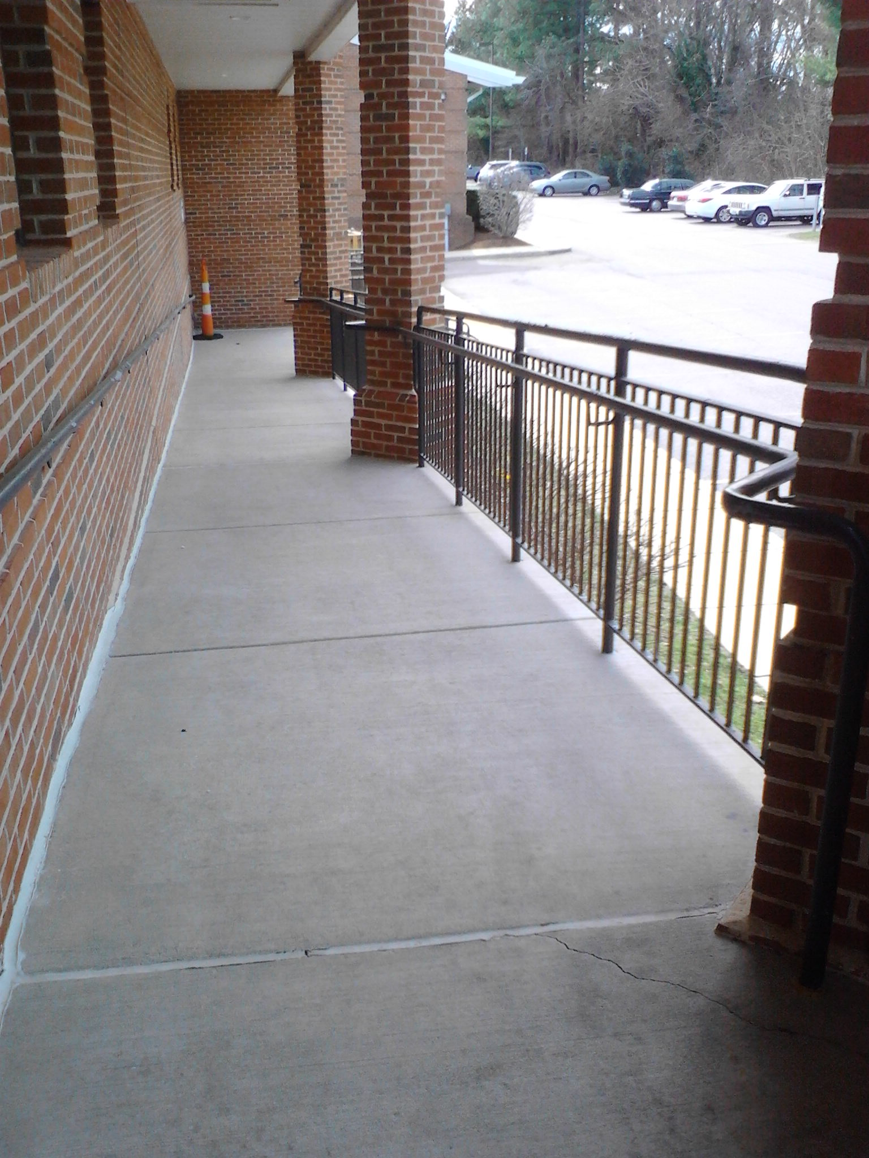
Unity Hall Kitchen
2 industrial refrigerators
1 industrial freezer
Industrial dish washer
Ample prep space
Easy access to Hall and outside ramp

Slide 9
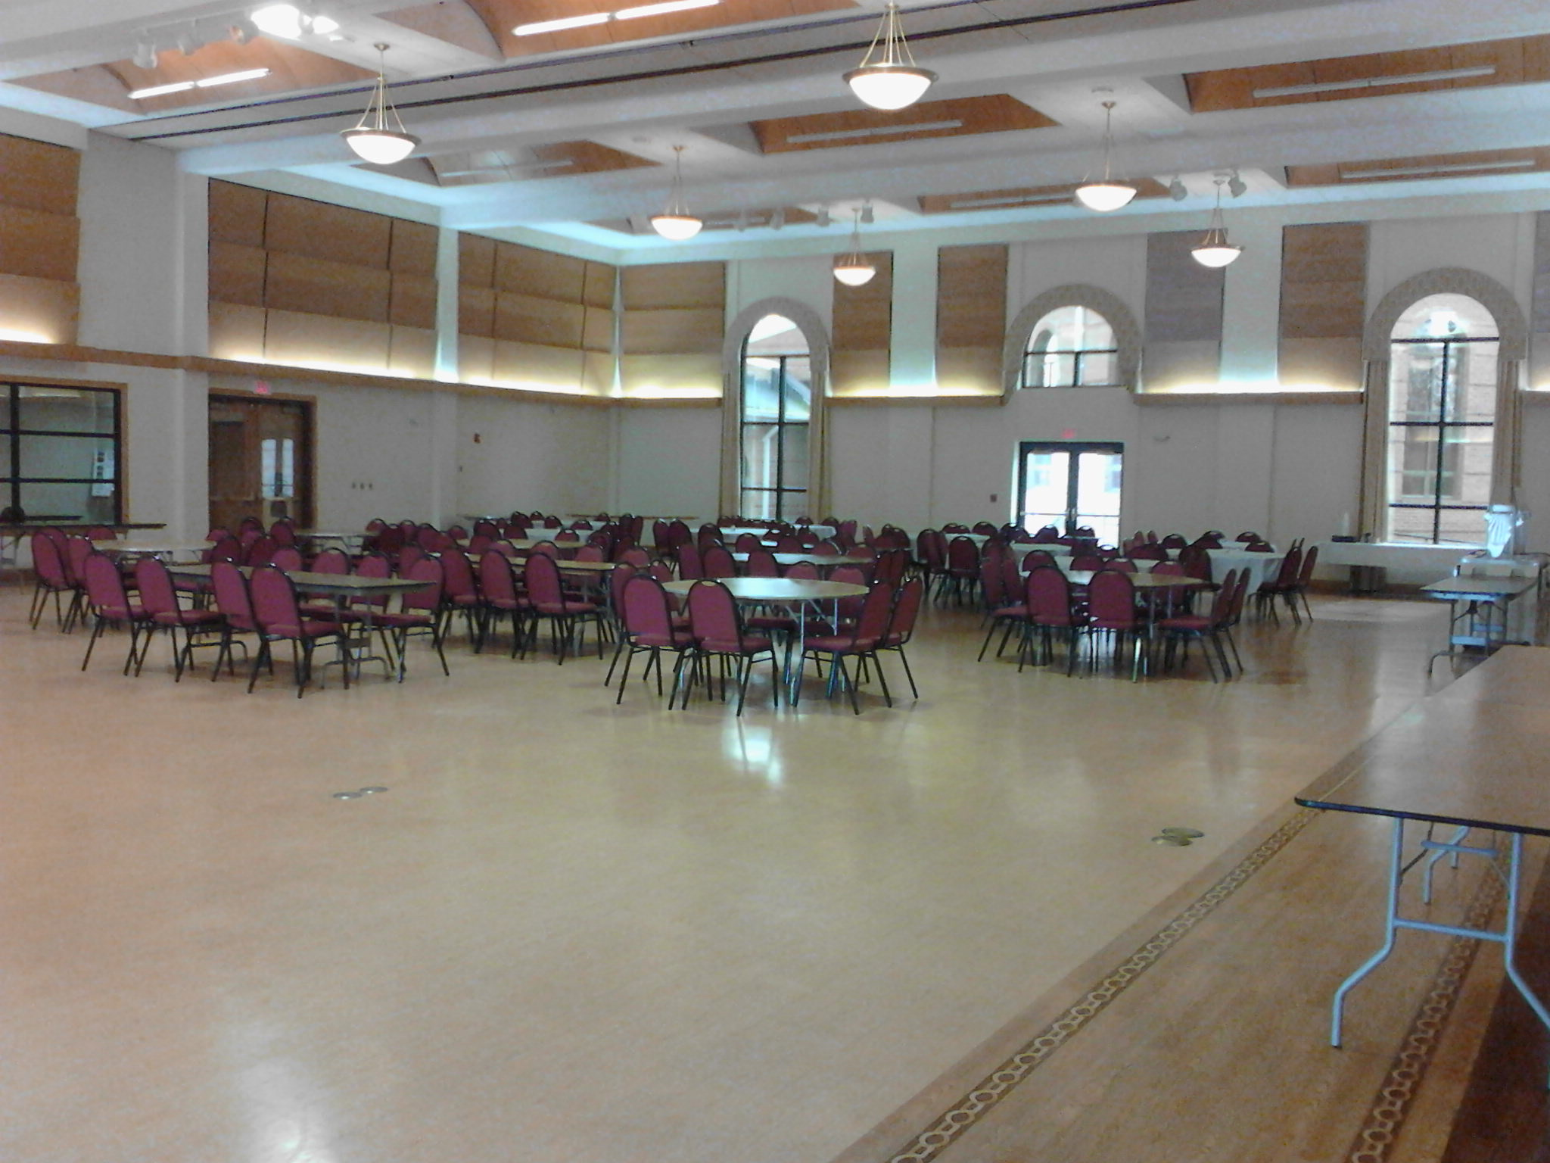
Unity Hall
4,941 square feet of beautifully laid wood floor.
25 foot ceilings with chandelier lighting.
Easy access to terrace or lobby.

Slide 10
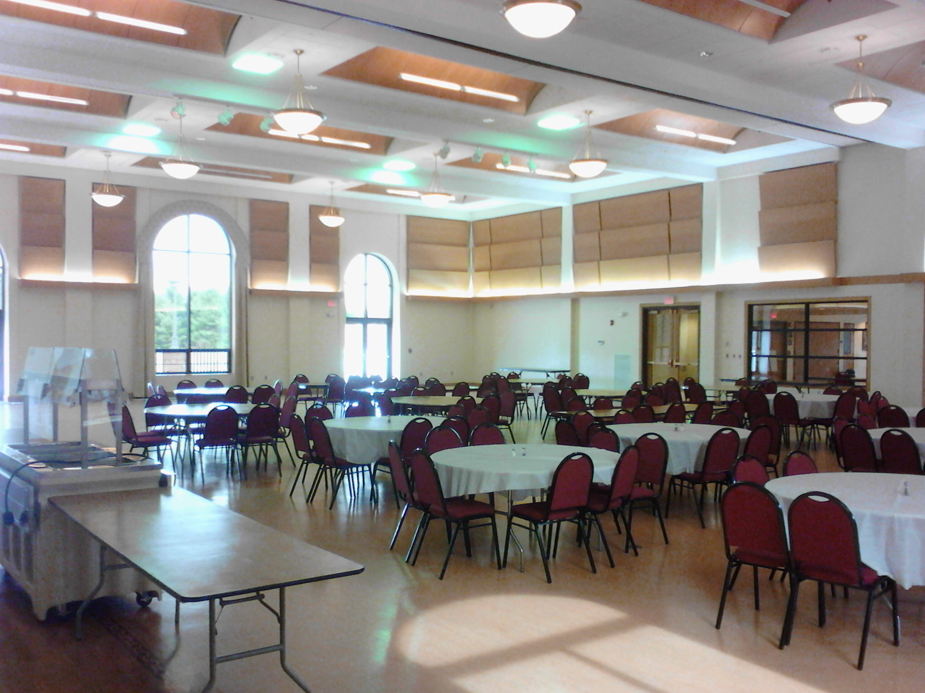
Unity Hall
Rentals include 42 six-foot round tables with burgundy cloth covered chairs.
13 eight-foot rectangular tables for serving or display.
5 six-foot rectangular tables for serving or display.

Slide 11
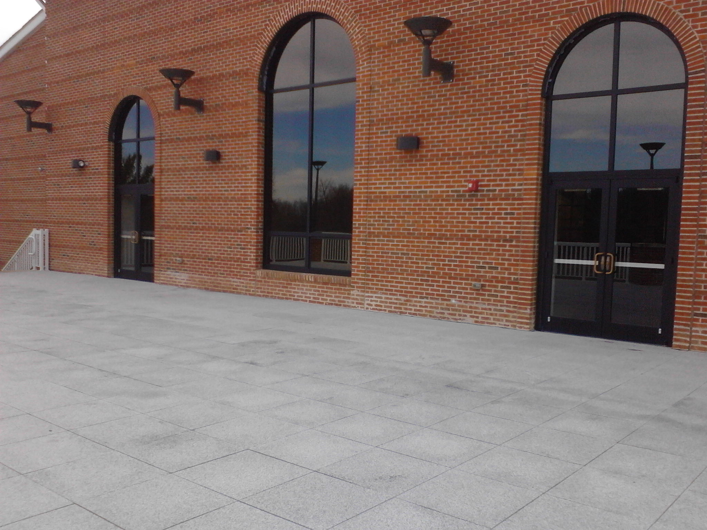
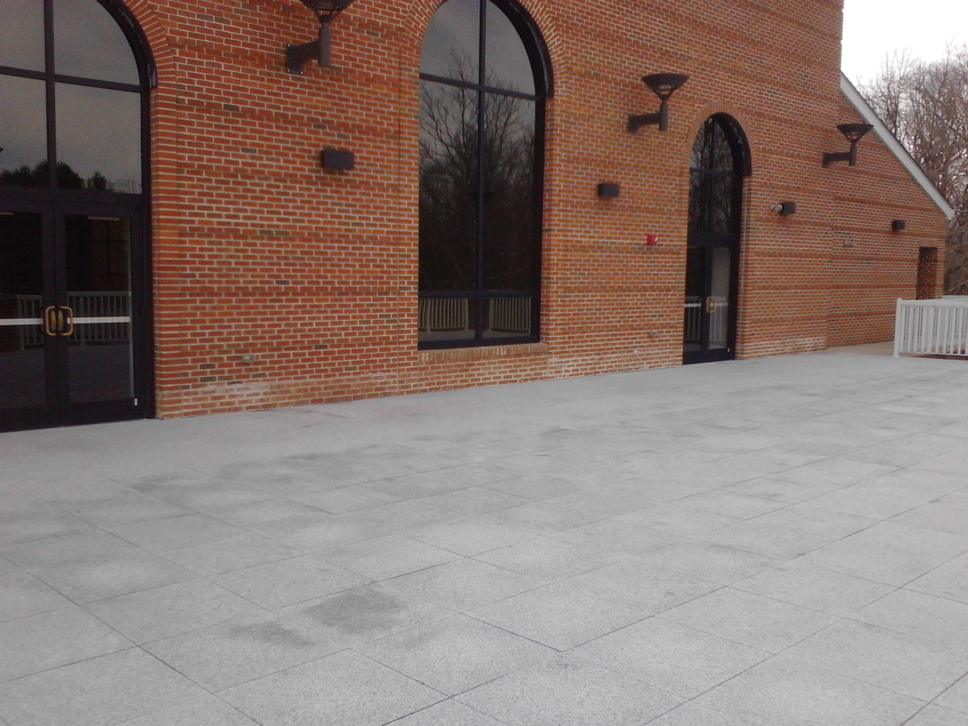
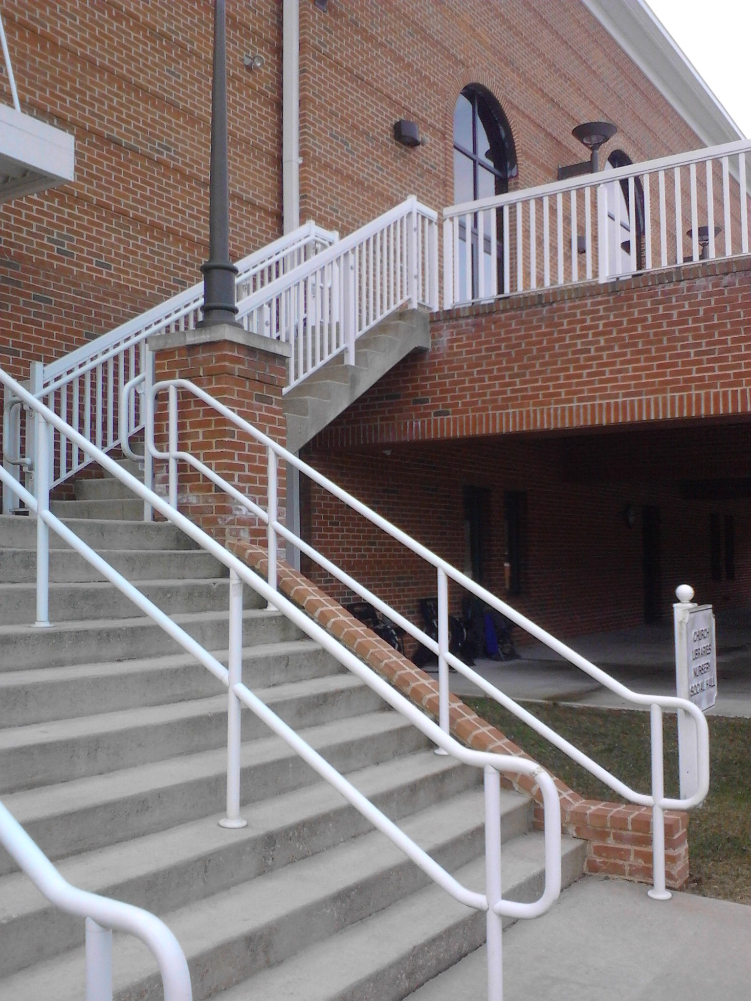
Unity Hall Terrace
1,922 square foot terrace for use by guests renting entire Hall or 2/3.
Church furniture may not be used on the terrace – please supply your own furnishings.
Easy access to Hall and Event Parking.

Slide 12
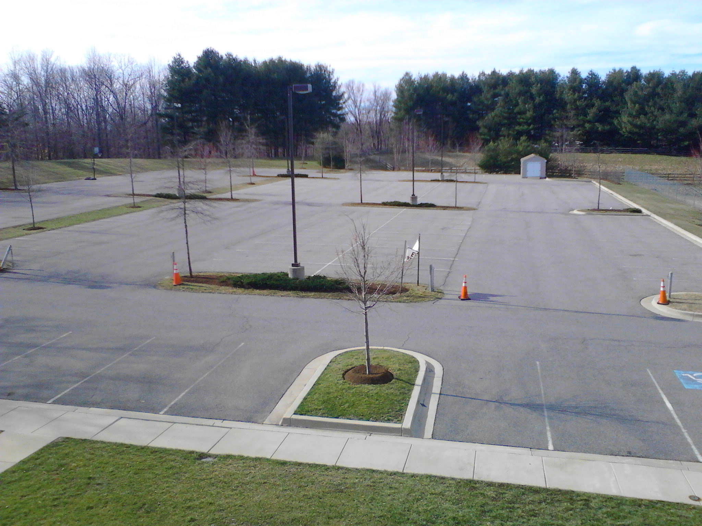
Event Parking
Over 200 Event Parking spaces in well lit area
Easy access for limos, buses, trolley

Slide 13
For more information or to reserve Unity Hall, please contact the Hall Manager at
hallmgr@hfccmail.org or
call 410/269-0586

