Slide 2
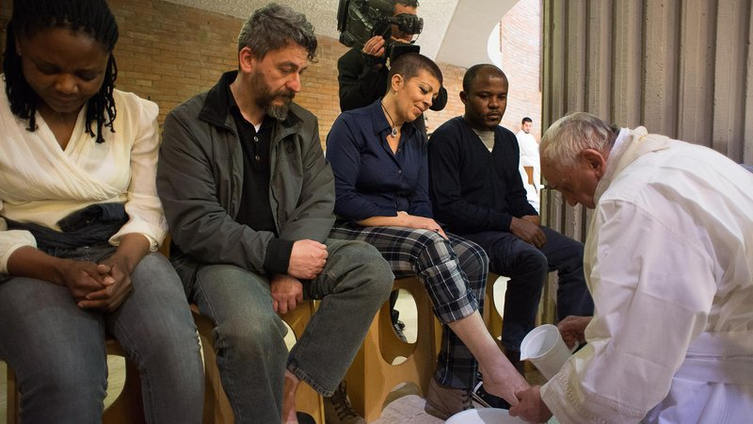
Maybe you are a member of Holy Family, or maybe not …

Slide 3
Maybe you are a member of Holy Family, or maybe not …
Maybe you are Catholic, maybe not.

Slide 4
Maybe you are a member of Holy Family, or maybe not …
Maybe you are Catholic, maybe not.
Maybe you are a churchgoer,
maybe not.

Slide 5
Maybe you are a member of Holy Family, or maybe not …
Maybe you are Catholic, maybe not.
Maybe you are a churchgoer,
maybe not.
Whatever your situation…

Slide 6
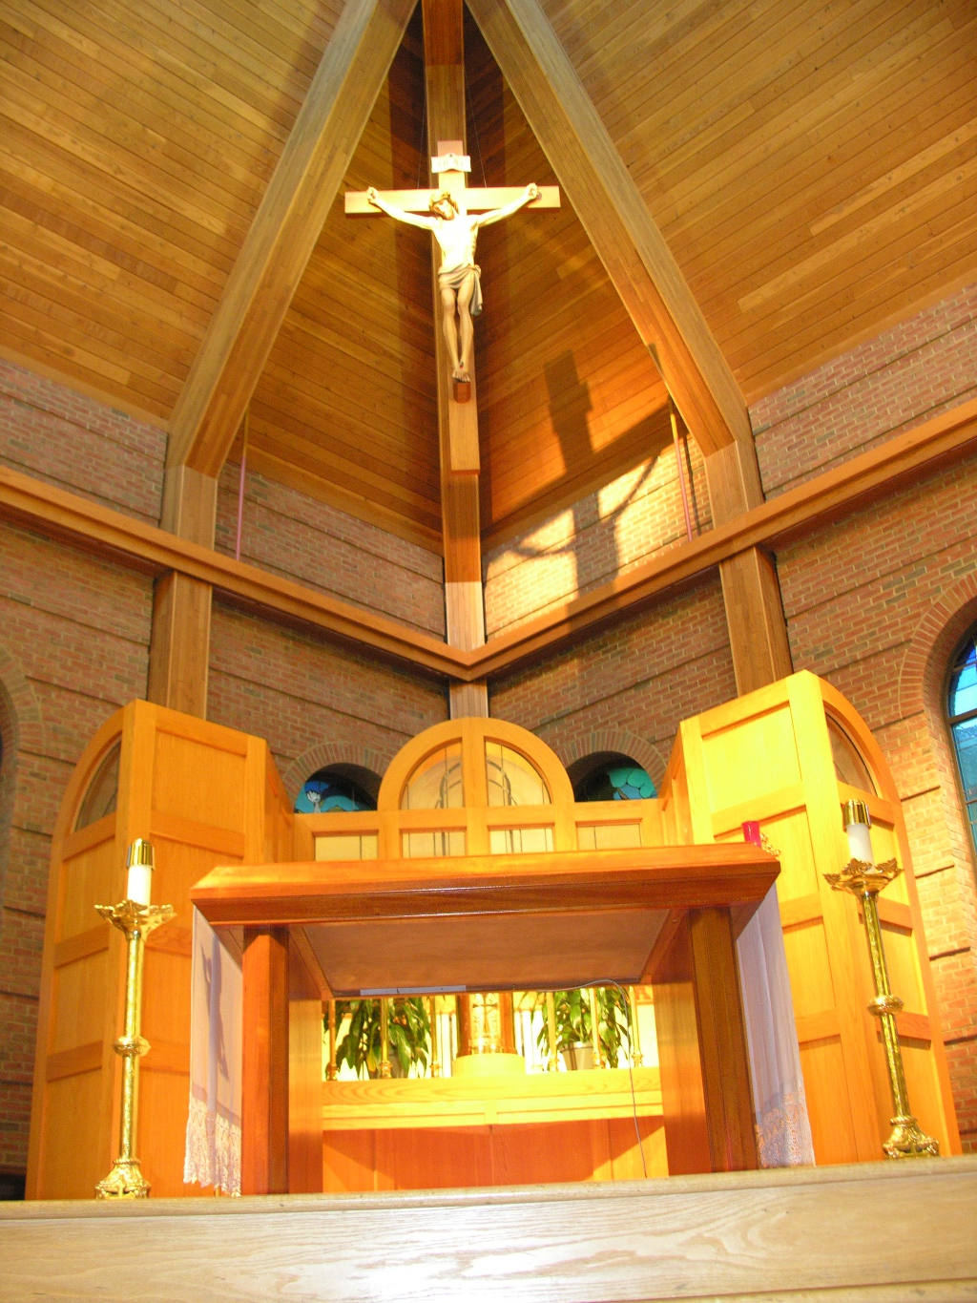
YOU ARE WELCOME HERE

Slide 7
YOU ARE WELCOME HERE
Today, and the next two sessions (June 3 and 10) we plan to go over what Catholics believe and why.

Slide 8
YOU ARE WELCOME HERE
Today, and the next two sessions (June 3 and 10) we plan to go over what Catholics believe and why.
We will try to keep each meeting to 1 hour to respect people’s schedules.

Slide 9
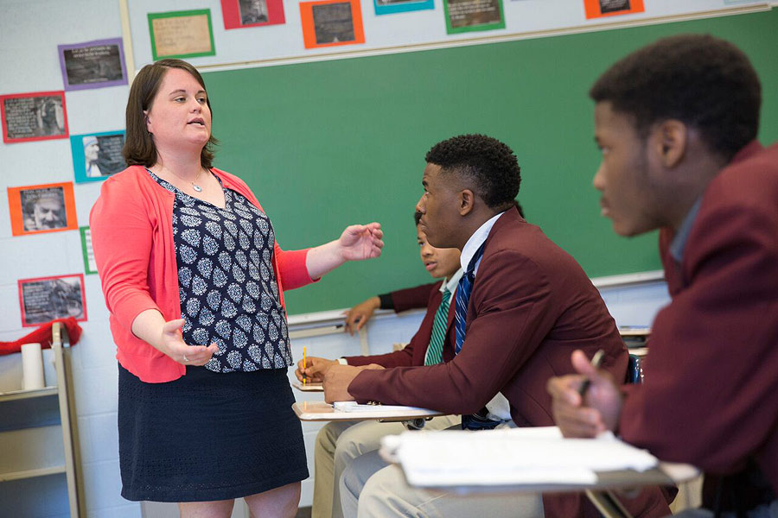
The Sacrament of Confirmation
If you are a Catholic who has ALREADY BEEN BAPTIZED AND HAD YOUR FIRST COMMUNION, you are
invited to get CONFIRMED
after attending the three
classes.

Slide 10
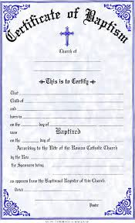
The Sacrament of Confirmation
You will need to get ahold of a NEWLY ISSUED Baptism Certificate from wherever you were baptized...just contact the church where you were baptized and ask them to send you a new copy now.

Slide 11
The Sacrament of Confirmation
You will need to get ahold of a NEWLY ISSUED Baptism Certificate from wherever you were baptized...just contact the church where you were baptized and ask them to send you a new copy now.
Unfortunately, we cannot accept Xerox copies of old certificates...but, instead, we will need a new copy issued by the parish where you were baptized.

Slide 12
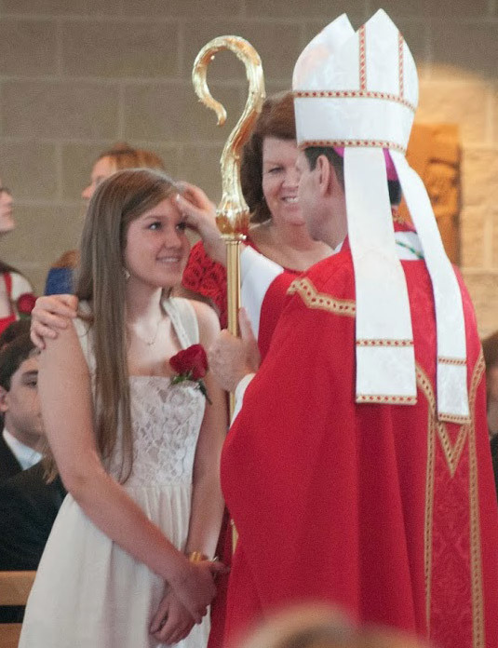
The Sacrament of Confirmation
3. And please think about who you would want to be your SPONSOR...who is sort of like a godparent was at your baptism. You only need one sponsor...they do need to be a Catholic who has received the sacrament of confirmation and is at least 16 years old to be your sponsor.

Slide 13
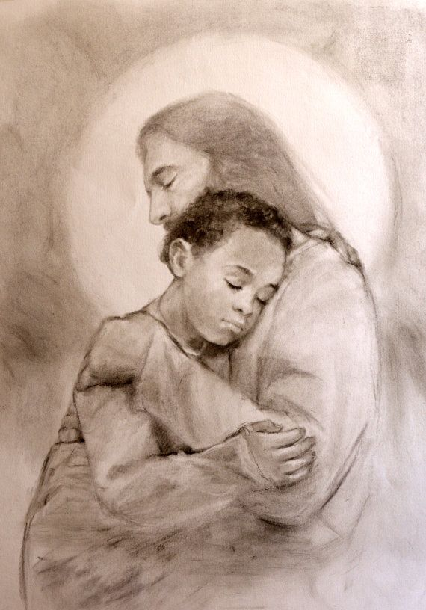
Catholicism 101: JESUS
A reason to follow Jesus: His story is the best story out there!
It is good to treat the beliefs of all people with respect. But, having said that, I love my Christian faith and the story it tells the best. I am glad I am a Christian.

Slide 14
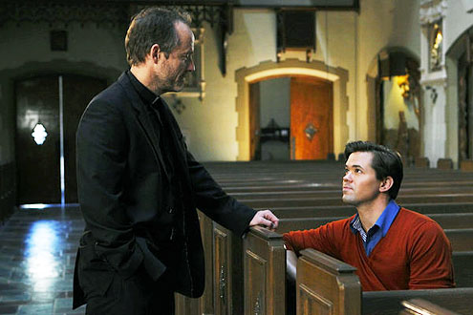
Catholicism 101: JESUS
A reason to follow Jesus: His story is the best story out there!
Reminds me of a conversation I had with a fellow a ways back who said that he “used to be Catholic” but now he was into another religion, and he wanted to know why I liked being Catholic and I said,

Slide 15
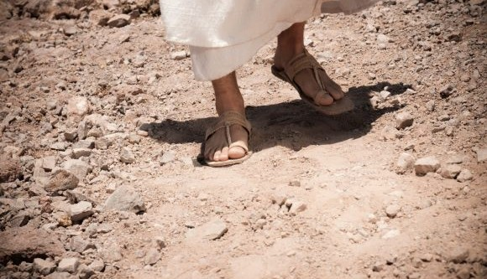
Catholicism 101: JESUS
A reason to follow Jesus: His story is the best story out there!
“I like the idea that God became one of us → that in Christianity God came into our existence and slugged it out in the mud with us”.

Slide 16
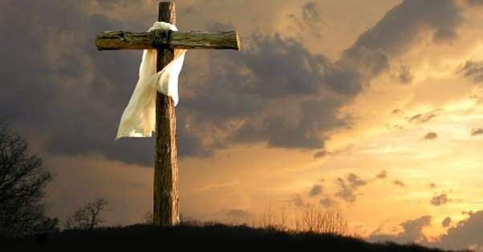
Catholicism 101: JESUS
A reason to follow Jesus: His story is the best story out there!
And our God loves us, even to the point OF DYING FOR US

Slide 17
Catholicism 101: JESUS
A reason to follow Jesus: His story is the best story out there!
And our God loves us, even to the point OF DYING FOR US
That is powerful!

Slide 18
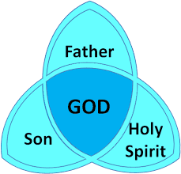
Catholicism 101: JESUS
A reason to follow Jesus: His story is the best story out there!
Even the very nature of God, in Christianity, is about a loving relationship, the Trinity: A loving union of Father, Son and Spirit.

Slide 19
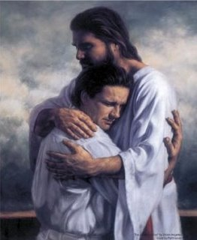
Catholicism 101: JESUS
A reason to follow Jesus: His story is the best story out there!
That the Son loves the Father and the Father loves the Son is repeated many times in the New Testament.

Slide 20
Catholicism 101: JESUS
A reason to follow Jesus: His story is the best story out there!
Jesus also says that if we love Him, and keep his commandments, then the Father will give you another Helper, to be with you always.

Slide 21
Catholicism 101: JESUS
A reason to follow Jesus: His story is the best story out there!
He is the Spirit of truth (John 14: 15) and that “…the Helper, the Holy Spirit, whom the Father will send in my name, will teach you all things and remind you of everything that I have told you.” (John 14:26.)

Slide 22
Catholicism 101: JESUS
A reason to follow Jesus: His story is the best story out there!
So God: Father, Son and Spirit, is a loving family….all one God, but still a family like a musical chord made of three notes, or three leaves on one clover, or three bottles of wine gotten from one barrel.

Slide 23
Catholicism 101: JESUS
A reason to follow Jesus: His story is the best story out there!
The Christian story of God, then, is all about GREAT LOVE. Great love within God, in the Trinity…that spilled out and created us (out of love.)

Slide 24
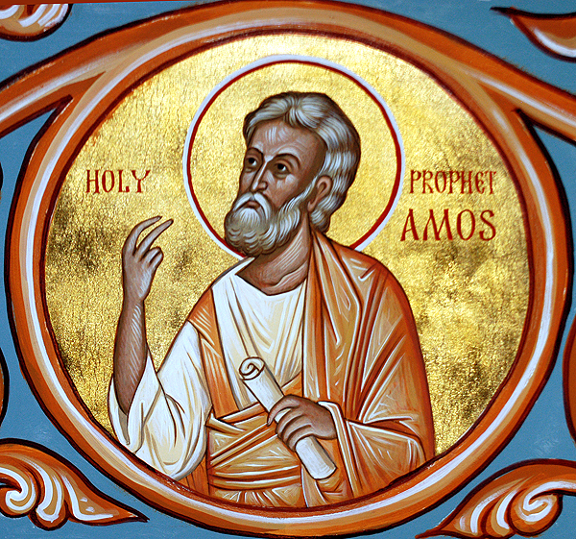
Catholicism 101: JESUS
A reason to follow Jesus: His story is the best story out there!
The Jewish tradition, from which the Christian faith sprang, is also singularly about a unique love of God for His people. Indeed, unlike any other people, the People of Israel got this idea of being so loved by God that, in the Book of the Prophet Amos God compares his love for Israel to be like one of a husband for a wife that doesn’t love him back.

Slide 25
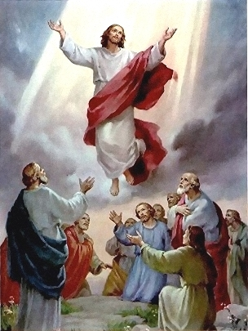
Catholicism 101: JESUS
Following Jesus: Why did the apostles all risk their lives unless Jesus HAD risen again?

Slide 26
Catholicism 101: JESUS
Following Jesus: Why did the apostles all risk their lives unless Jesus HAD risen again?
In Jennifer Fulwiler’s book, Something Other Than God, she writes about finding a book called A Case for Christ, A Journalist’s Personal Investigation of the Evidence for Jesus” by Lee Stroebel.
Jennifer writes, in a blog on www.whyimcatholic.com …

Slide 27
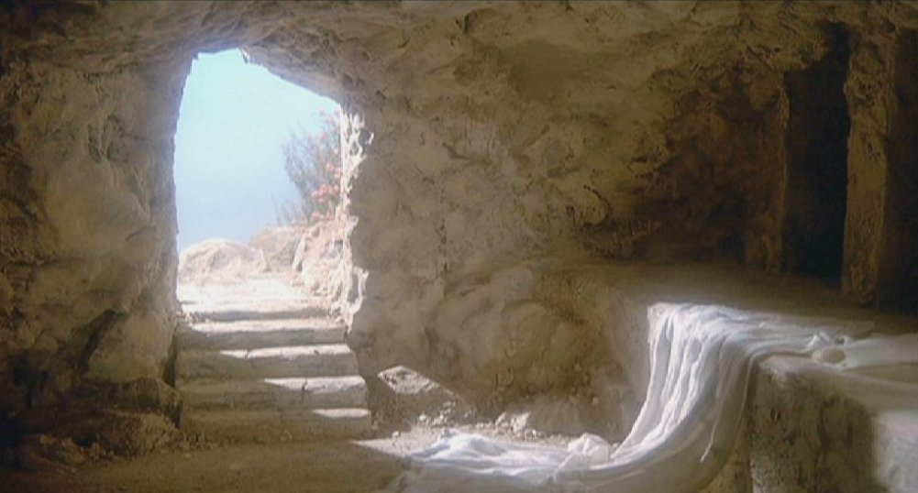
Catholicism 101: JESUS
Following Jesus: Why did the apostles all risk their lives unless Jesus HAD risen again?
“(Stroebel’s)... book pointed out that thousands of Jewish people abandoned the sacred practices that had sustained them through centuries, through all types of persecution, in the years after the death of Jesus of Nazareth.

Slide 28
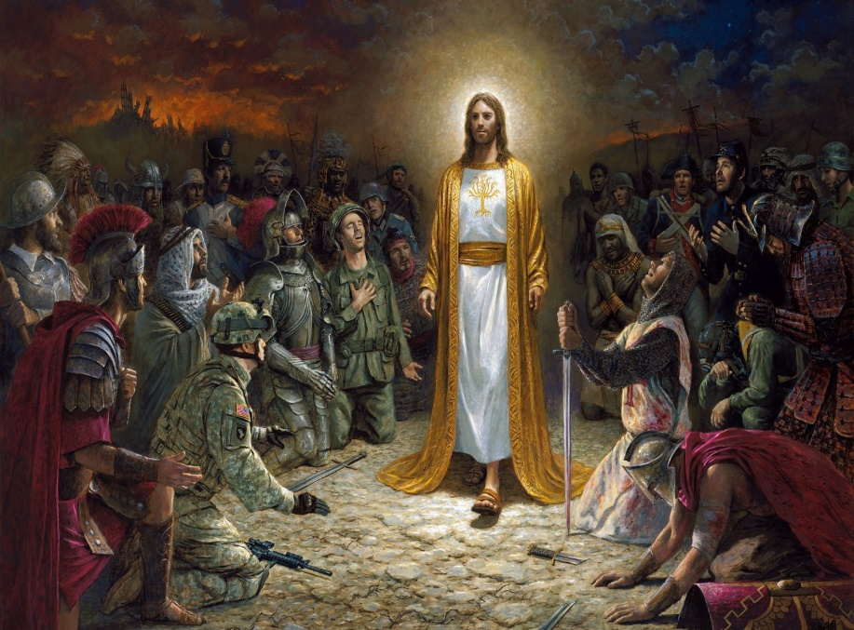
Catholicism 101: JESUS
Following Jesus: Why did the apostles all risk their lives unless Jesus HAD risen again?
Almost all of Jesus' original followers (and, I would add, almost all of his apostles) went to their death rather than recant their statements that they'd seen him rise from the dead.

Slide 29
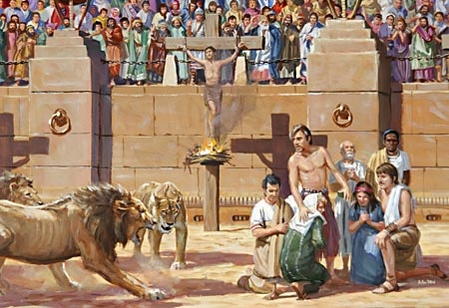
Catholicism 101: JESUS
Following Jesus: Why did the apostles all risk their lives unless Jesus HAD risen again?
And Christianity spread like wildfire in the early centuries, despite the fact that becoming a Christian often meant persecution or even death.”

Slide 30
Catholicism 101: JESUS
Following Jesus: Why did the apostles all risk their lives unless Jesus HAD risen again?
“Nearly all that we call human history …
[is] the long terrible story of man trying to find
something other than God
which will make him happy.”
C. S. Lewis, Mere Christianity

Slide 31
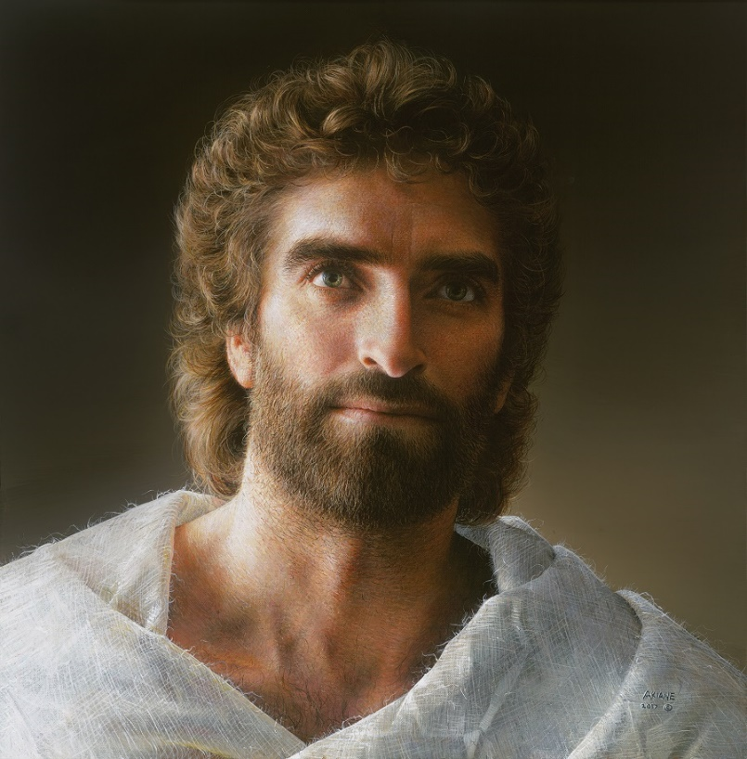
Catholicism 101: JESUS
Believing in Jesus: He said he was God – so either he was God or he was a liar or he was crazy.

Slide 32
Catholicism 101: JESUS
Believing in Jesus: He said he was God – so either he was God or he was a liar or he was crazy.
Jesus was not just a good person or a good teacher, Jesus said that he was God. In the Gospels Jesus called himself “The Son of Man” 80 times.

Slide 33
Catholicism 101: JESUS
Believing in Jesus: He said he was God – so either he was God or he was a liar or he was crazy.
His listeners got furious because they, rightly, interpreted his saying this as connecting to the Book of Daniel 7:13-14 where Daniel writes about seeing a great king of all → and Daniel calls him the “son of man.

Slide 34
Catholicism 101: JESUS
Believing in Jesus: He said he was God – so either he was God or he was a liar or he was crazy.
I saw coming with the clouds of heaven. One like a son of man. When he reached the Ancient of Days and was presented before him, he received dominion, splendor, and kingship; all nations, peoples and tongues will serve him. His dominion is an everlasting dominion that shall not pass away, his kingship, one that shall not be destroyed.

Slide 35
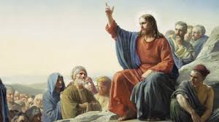
Catholicism 101: JESUS
Believing in Jesus: He said he was God – so either he was God or he was a liar or he was crazy.
So Jesus was letting the people of his time know that he was the Messiah, the Savior, and the King of all.

Slide 36
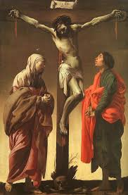
Catholicism 101: JESUS
Believing in Jesus: He said he was God – so either he was God or he was a liar or he was crazy.
Maybe Jesus was a liar: Though this doesn’t seem to square with his goodness. And what happened after he died on the cross, anyway, if all of his disciples, who were terrified before his death, claimed he had risen and died saying so … could it be that they were all liars or crazy too?

Slide 37
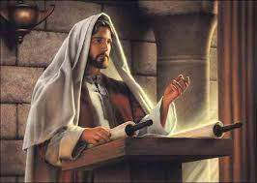
Catholicism 101: JESUS
Believing in Jesus: He said he was God – so either he was God or he was a liar or he was crazy.
Maybe Jesus was crazy: Though that, again, doesn’t seem to square itself with Jesus being one of the greatest moral teachers of all time. And also, again, all of his disciples, who also were martyred because they claimed he was God and that he was risen from the dead, and died
as martyrs saying so, would they all be
liars or crazy too?

Slide 38
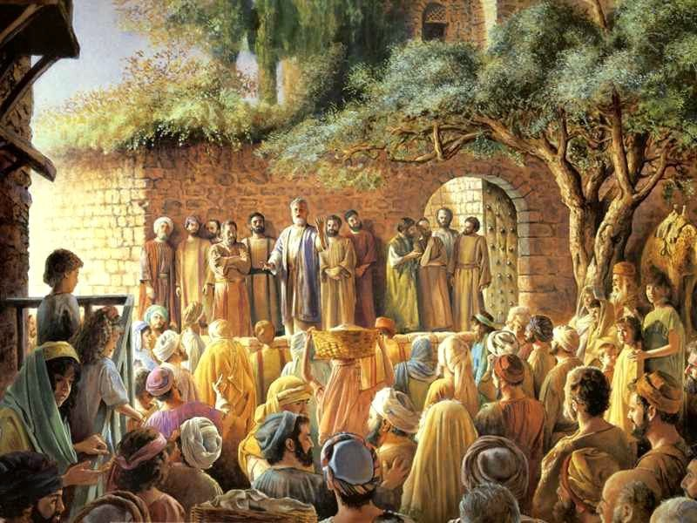
Catholicism 101: JESUS
Believing in Jesus: All the people who wrote down what He did in the Gospels of Matthew, Mark, Luke and John were living in communities of eye-witnesses to Jesus.
The New Testament was written IN A DIFFERENT WAY from the way some other famous religious texts were written. After Jesus died and then rose from the dead, people in different places at slightly different times began to write down what
Jesus had done and said among them – between 25 and 50 years later. And this would have been done in communities where many witnesses to

Slide 39
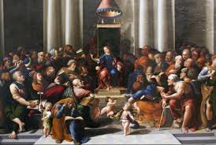
Catholicism 101: JESUS
Believing in Jesus: All the people who wrote down what He did in the Gospels of Matthew, Mark, Luke and John were living in communities of eye-witnesses to Jesus.
Jesus’s life and actions would have been present. So the stories of His miracles and words? Lot’s of people would have still been around who had known and lived with Jesus to verify or contradict what was written down in those Gospels.

Slide 40
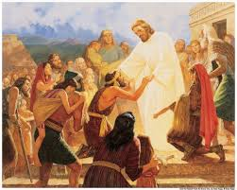
Catholicism 101: PRAYER
THE POINT OF PRAYER, for a Christian, is Christ and His Church:
Christians believe that Jesus is the most important way to find God’s grace in our world – God comes into our midst in a manner that we could see, touch, and hear.

Slide 41
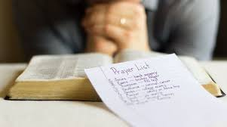
Catholicism 101: PRAYER
THE POINT OF PRAYER, for a Christian, is Christ and His Church:
Therefore, the main focus of Christian prayer is to get to know Jesus, our Savior. For a Christian, prayer is ultimately about a RELATIONSHIP with Jesus Christ – personally and through being part of the Church that Jesus gave us.

Slide 42
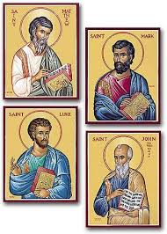
Catholicism 101: PRAYER
THE POINT OF PRAYER, for a Christian, is Christ and His Church:
How do we do this? How do we grow in our relationship with Jesus Christ? One thought would be that focusing on THE FOUR GOSPELS (Matthew, Mark, Luke and John) also is a way to introduce ourselves, bit by bit, to JESUS – for the Gospels are the actual words and actions of Jesus Christ. As St. Jerome said in the 4th century: “Ignorance of Scripture is ignorance of Christ.”

Slide 43
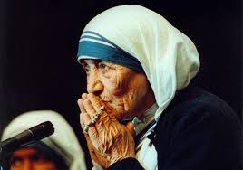
Catholicism 101: PRAYER
THE POINT OF PRAYER, for a Christian, is Christ and His Church:
We also can see HOW OTHERS followed Christ through looking at the LIVES OF THE SAINTS (i.e. – look to Mother Teresa of Calcutta, Francis of Assisi or Elizabeth Ann Seton or others to see HOW THEY tried to find Christ and to see Christ in others.)

Slide 44
Catholicism 101: PRAYER
THE POINT OF PRAYER, for a Christian, is Christ and His Church:
We can also find good examples or role models in living a life that leads us to Christ through OTHER PEOPLE THAT WE KNOW – people in our parish, in our family, etc.

Slide 45
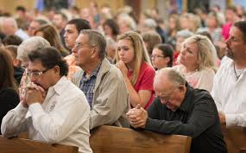
Catholicism 101: PRAYER
THE POINT OF PRAYER, for a Christian, is Christ and His Church:
And we AUGMENT our personal prayer life, and assist our own journey of faith, when we take advantage of PRAYING WITH OTHERS in the sacraments, in our faith community, etc.

Slide 46
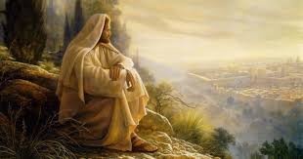
Catholicism 101: PRAYER
THE POINT OF PRAYER, for a Christian, is Christ and His Church:
What Did Jesus’s Words and Actions Say About Prayer
Here are a few things that Jesus told us about prayer or SHOWED us about prayer through his example:

Slide 47
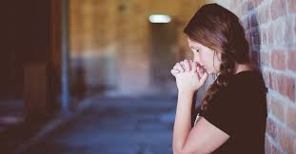
Catholicism 101: PRAYER
THE POINT OF PRAYER, for a Christian, is Christ and His Church:
What Did Jesus’s Words and Actions Say About Prayer
Here are a few things that Jesus told us about prayer or SHOWED us about prayer through his example:
First of all he warned that we not parade our prayer or our fasting or our good works so that others will see them. (Mt. 6:3), (Mt. 6:5) (Mt. 6:6)
and (Mt. 6:18.) Jesus also cautioned that PRAYER needs to be sincere (Luke 7:44).

Slide 48
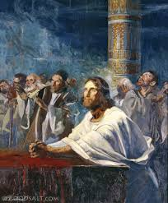
Catholicism 101: PRAYER
THE POINT OF PRAYER, for a Christian, is Christ and His Church:
What Did Jesus’s Words and Actions Say About Prayer
Second: He prayed with the larger community of faith – he wasn’t a lone ranger when it came to faith. He practiced community by going to synagogue (Luke 4 says that Jesus went to the synagogue on the Sabbath Day “as he was in the habit of doing.” And community was central, of course, to

Slide 49
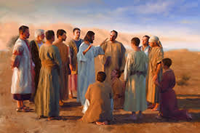
Catholicism 101: PRAYER
THE POINT OF PRAYER, for a Christian, is Christ and His Church:
What Did Jesus’s Words and Actions Say About Prayer
the whole way Jesus went on his mission – gathering a group of disciples who lived and prayed and ministered together, and then STARTING THE CHURCH to be a continuation of that community of disciples he began after the Resurrection.

Slide 50
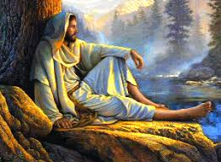
Catholicism 101: PRAYER
THE POINT OF PRAYER, for a Christian, is Christ and His Church:
What Did Jesus’s Words and Actions Say About Prayer
Third: While community is important, we can also see from the life of Jesus that he promoted that we NEED times of silence in our lives to keep up a relationship with God. How do we “come away” by ourselves “to a deserted place to rest for a while” (Mk 6:31)?

Slide 51
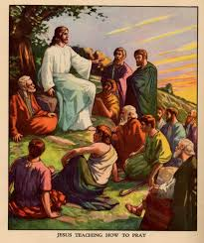
Catholicism 101: PRAYER
THE POINT OF PRAYER, for a Christian, is Christ and His Church:
What Did Jesus’s Words and Actions Say About Prayer
When the disciples ask Jesus how to pray, He teaches them the Our Father. (Lk 11: 1-4, Mt 6:9-10). Let’s look at the “Our Father” then, the prayer that Jesus taught us, as a guide to prayer:

Slide 52
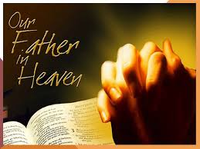
Catholicism 101: PRAYER
THE POINT OF PRAYER, for a Christian, is Christ and His Church:
What Did Jesus’s Words and Actions Say About Prayer
When the disciples ask Jesus how to pray, He teaches them the Our Father. (Lk 11: 1-4, Mt 6:9-10). Let’s look at the “Our Father” then, the prayer that Jesus taught us, as a guide to prayer:
Our Father in heaven, hallowed be your name. – Our prayer is about
turning to God as our Father – as a God who loves us – and to reverence God in our lives (“keep holy” his name.)

Slide 53
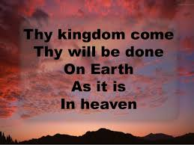
Catholicism 101: PRAYER
THE POINT OF PRAYER, for a Christian, is Christ and His Church:
What Did Jesus’s Words and Actions Say About Prayer
Thy kingdom come, Thy will be done on earth as it is in heaven. – Our prayer is to pray FOR the coming of the Kingdom of God/that God’s will be done in the world AND that God STRENGTHEN US TO WORK FOR THE COMING OF THE KINGDOM IN THE WORLD/to do His will in the world.

Slide 54
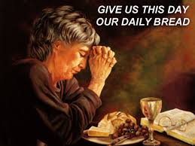
Catholicism 101: PRAYER
THE POINT OF PRAYER, for a Christian, is Christ and His Church:
What Did Jesus’s Words and Actions Say About Prayer
Give us this day our daily bread, -- We pray that God provide for us in our journey of faith. Could bread also be interpreted as our spiritual bread?

Slide 55
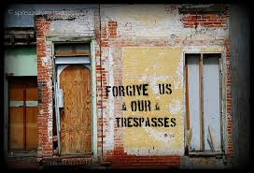
Catholicism 101: PRAYER
THE POINT OF PRAYER, for a Christian, is Christ and His Church:
What Did Jesus’s Words and Actions Say About Prayer
Give us this day our daily bread, -- We pray that God provide for us in our journey of faith. Could bread also be interpreted as our spiritual bread?
and forgive us our trespasses as we forgive those who trespass against us – An important part of the
Christian life is giving and seeking forgiveness.

Slide 56
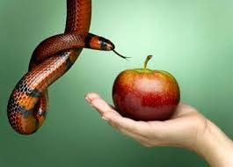
Catholicism 101: PRAYER
THE POINT OF PRAYER, for a Christian, is Christ and His Church:
What Did Jesus’s Words and Actions Say About Prayer
And lead us not into temptation, but deliver us from evil. – Our prayer time is a time to ask for the help of God to keep us from sin and to protect us from evil: TO ASK FOR GOD’S HELP!

Slide 57
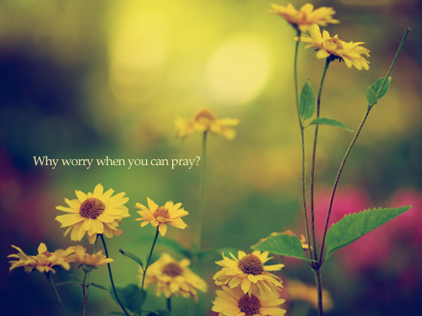
Catholicism 101: PRAYER
THE POINT OF PRAYER, for a Christian, is Christ and His Church:
Just Do It
Sometimes people worry about how to pray … and we will get into a lot of different ways to pray in this text, but the only way to learn how to get into this relationship with Jesus Christ is to DO it. Every person is different, so the way that you end up generally praying might be very different from how other people pray.

Slide 58
Catholicism 101: PRAYER
THE POINT OF PRAYER, for a Christian, is Christ and His Church:
Just Do It
At the same time, one great part of being in a community of faith (like the Catholic community) is that you don’t have to invent the wheel, constantly, when it comes to faith. Indeed, we come from a long tradition of very prayerful and holy people – and many saints and great minds

Slide 59
Catholicism 101: PRAYER
THE POINT OF PRAYER, for a Christian, is Christ and His Church:
Just Do It
have weighed in on different ways to pray. So you have all of their ideas and inspirations to help you too ...

Slide 60
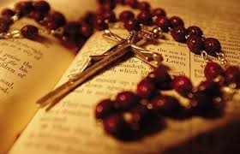
Catholicism 101: PRAYER
THE POINT OF PRAYER, for a Christian, is Christ and His Church:
Just Do It
SO – using the best of Christian tradition AND following your heart….just get started. Sit in a chair, go on a walk, get a Bible, find some good prayers, have a rosary, listen to inspiring music, use religious art … every-body’s different. Figure out a time when you can be quiet (and where) – whether
That’s at home, at work or even in your car.

Slide 61
Catholicism 101: PRAYER
THE POINT OF PRAYER, for a Christian, is Christ and His Church:
Just Do It
And start. Then later we can reassess if we are praying at the optimum time or if we need to make some changes, but let’s start.

Slide 62
Catholicism 101: PRAYER
THE POINT OF PRAYER, for a Christian, is Christ and His Church:
Maybe Start Off Slow
Sometimes we have to start out slow…. And not be overly ambitious. For example, recently, on the pastoral council where I work as a priest, one of the members of the council stated, “People will ask me, how can you do a whole hour and pray in front of the Blessed Sacrament, how do you do that???”

Slide 63
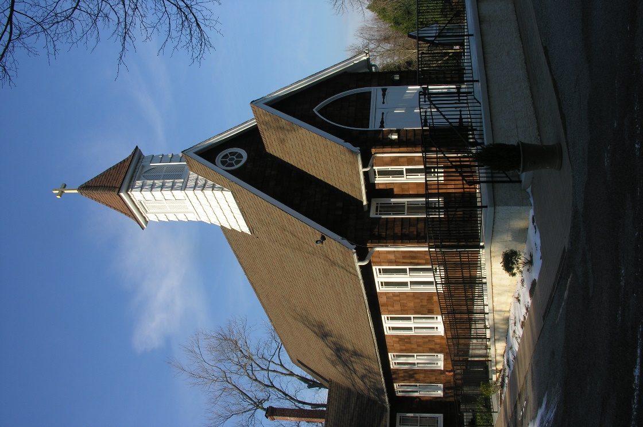
Catholicism 101: PRAYER
THE POINT OF PRAYER, for a Christian, is Christ and His Church:
Maybe Start Off Slow
She thought that maybe we can encourage people to start out by coming to the chapel or the Blessed Sacrament Oratory for 5 or 10 minutes to pray, and then to build from there.

Slide 64
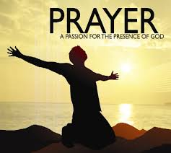
Catholicism 101: PRAYER
THE POINT OF PRAYER, for a Christian, is Christ and His Church:
Maybe Start Off Slow
Another time I heard about a suggestion for people who are having trouble keeping a commitment to pray: The person that taught me this said, “I know so many people who make a big commitment to God to maybe pray 30 minutes every morning … but they don’t keep that commitment and then they stop praying

Slide 65
Catholicism 101: PRAYER
THE POINT OF PRAYER, for a Christian, is Christ and His Church:
Maybe Start Off Slow
entirely because they feel bad about not keeping their commitment. SO, this person said, “Instead, start out small and KEEP your promise to God and BUILD UP from there … So, his rule was the “two and two rule”: To take two minutes in the morning to pray, and when you are done, to put

Slide 66
Catholicism 101: PRAYER
THE POINT OF PRAYER, for a Christian, is Christ and His Church:
Maybe Start Off Slow
the Bible or your prayer book on your pillow. Then in the evening, before you can sleep, you have to take the book from your pillow and pray two more minutes (at least), this time using the Bible/Breviary/book. Then you put your book on the shoes you will wear the next
day and you have to pick up the book in the morning and pray two minutes (again) before you can put on your shoes.
Start small and keep your commitment, and then build up from there.

Slide 67
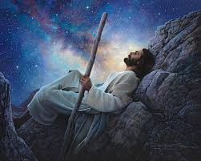
Catholicism 101: PRAYER
THE POINT OF PRAYER, for a Christian, is Christ and His Church:
Silence
Jesus sought out quiet times away from everyone else in the Scriptures, and encouraged his disciples to do that same. So, let’s follow Jesus’s example and advice to just be quiet SOMETIMES IF WE WANT TO FIND GOD.

Slide 68
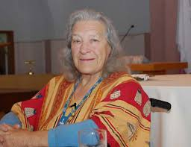
Catholicism 101: PRAYER
THE POINT OF PRAYER, for a Christian, is Christ and His Church:
Silence
However, IF WE ARE MORE ACTIVE, THIS CAN HAPPEN WHILE WE WALK OR RUN OR SOMETHING….But let’s get into the occasional habit of being quiet. Reminds me of a true story by Sr. Jose Hobday:
I was twelve years old and growing up in New Mexico. One Saturday I was
expecting my young friend Juanita to come over; but my friend could not come over after all, so I began to make a nuisance of myself with each

Slide 69
Catholicism 101: PRAYER
THE POINT OF PRAYER, for a Christian, is Christ and His Church:
Silence
member of the family. Finally my father had enough and he told me “Get an apple, a blanket, and a book and come with me”, and we got into the family truck and drove off. We drove about eight miles from home to a tree on the edge of a canyon. My father dropped me off with my apple,
blanket, and book, on a canyon ridge under a pinion tree. He told me he’d be back by evening, said “Now, learn to live with yourself” and he left.

Slide 70
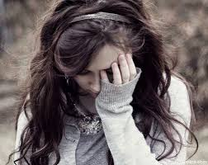
Catholicism 101: PRAYER
THE POINT OF PRAYER, for a Christian, is Christ and His Church:
Silence
I thought it was a little harsh so the first thing I did after he drove away was to throw the apple, the blanket, and the book off the edge of the cliff and sit down and cry. After a while though I began to notice where I was—it was a long time until evening. I climbed down the cliff to
recover my losses, stretched out on my blanket under the tree and began to read. It took a few hours, but gradually the world began to come alive for me

Slide 71
Catholicism 101: PRAYER
THE POINT OF PRAYER, for a Christian, is Christ and His Church:
Silence
in a new way. The sky got bigger, noises were new, the silence was loud, and I was in touch. I found myself sitting still, doing nothing. By the time evening came I was wiser: I had learned that something happens in solitude, that doesn’t happen any other way. From then on I began to go
off for long stretches into that land. I believe this was the beginning, in my life, for the lasting taste of the prayer of solitude.

Slide 72
Catholicism 101: PRAYER
THE POINT OF PRAYER, for a Christian, is Christ and His Church:
Silence
Of course, it sometimes takes a while to get ourselves used to silence … Indeed, the author Matthew Kelly in his book Four Signs of a Dynamic Catholic compares getting used to silence, in prayer, to how a couple, first dating, get used to silences together by the time they have been married for many years.

Slide 73
Catholicism 101: PRAYER
THE POINT OF PRAYER, for a Christian, is Christ and His Church:
Silence
But – even while it takes a while to get used to prayer, it is worth the effort to get used to some quiet time – whatever works – going for a walk, exercising while we are quiet, lingering after a daily mass during a lunch break to be quiet, listening to some music and then being quiet afterwards …

Slide 74
Catholicism 101: PRAYER
THE POINT OF PRAYER, for a Christian, is Christ and His Church:
Silence
but we find God not in just rolling through a lot of prayers or in quickly asking God to bless our day, but in following model of our Savior Jesus who sought out times of quiet … and the instructions He gave to the disciples. Jesus and his instructions are our model for prayer … So quiet time is important.

Slide 75
Catholicism 101: PRAYER
THE POINT OF PRAYER, for a Christian, is Christ and His Church:
Silence
The Catechism of the Catholic Church lists (Paragraph 2715) a comment that a parishioner in Ars, France told his priest, St. John Vianney, about his prayer, “When I was young I tried to tell God everything in prayer, later I got so I tried very hard to listen to God in prayer, now that I am old I
just look at him and he looks at me.

Slide 76
Catholicism 101: PRAYER
THE POINT OF PRAYER, for a Christian, is Christ and His Church:
Silence
So, while we want to have a structure and help to our prayer time, there needs to also be time to just be quiet with God.

Slide 77
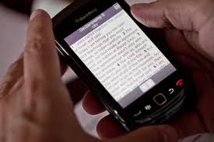
Catholicism 101: PRAYER
THE POINT OF PRAYER, for a Christian, is Christ and His Church:
Ways to Pray
Having said all of the above, what about the actual ACTION of prayer? Are there some ideas out there?
Can you keep a Bible or have access to the Bible electronically and read a passage of one of the four Gospels each day? And then pray about that
Passage? A few times recently Pope Francis has encouraged Christians to

Slide 78
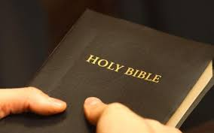
Catholicism 101: PRAYER
THE POINT OF PRAYER, for a Christian, is Christ and His Church:
Ways to Pray
Having said all of the above, what about the actual ACTION of prayer? Are there some ideas out there?
Keep a Bible with them at all times so that they can pray when inspired during the day. St. Jerome Press www.stjeromepress.com or 1/800-
845-2648 has Bibles from $4.25 and catechisms from $7.99.

Slide 79
Catholicism 101: PRAYER
THE POINT OF PRAYER, for a Christian, is Christ and His Church:
Ways to Pray
Having said all of the above, what about the actual ACTION of prayer? Are there some ideas out there?
OR refer to The Bible App: bible.com/app.

Slide 80
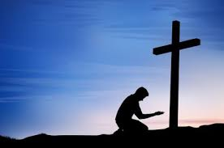
Catholicism 101: PRAYER
THE POINT OF PRAYER, for a Christian, is Christ and His Church:
Ways to Pray
Having said all of the above, what about the actual ACTION of prayer? Are there some ideas out there?
Can you spend some time during your prayer assessing how you have been acting towards other people (examine your life) and then asking God for help to be a good Christian?

Slide 81
Catholicism 101: PRAYER
THE POINT OF PRAYER, for a Christian, is Christ and His Church:
Ways to Pray
Having said all of the above, what about the actual ACTION of prayer? Are there some ideas out there?
Can you think of all the things that you are thankful for? Remember the faces and hear the voices of people who have been good to you?

Slide 82
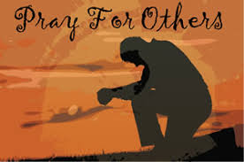
Catholicism 101: PRAYER
THE POINT OF PRAYER, for a Christian, is Christ and His Church:
Ways to Pray
Having said all of the above, what about the actual ACTION of prayer? Are there some ideas out there?
Can you lift up others in prayer? Ask God to bless family, friends, those in need?

Slide 83
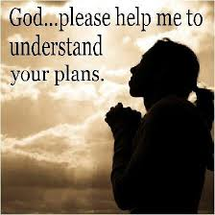
Catholicism 101: PRAYER
THE POINT OF PRAYER, for a Christian, is Christ and His Church:
Ways to Pray
Having said all of the above, what about the actual ACTION of prayer? Are there some ideas out there?
Can you ask God to help you be a better Christian?

Slide 84
Catholicism 101: PRAYER
THE POINT OF PRAYER, for a Christian, is Christ and His Church:
Ways to Pray
Having said all of the above, what about the actual ACTION of prayer? Are there some ideas out there?
Can you pray a decade of the rosary? Or a whole rosary. Go to www.catholic.org.

Slide 85
Catholicism 101: PRAYER
THE POINT OF PRAYER, for a Christian, is Christ and His Church:
Ways to Pray
Having said all of the above, what about the actual ACTION of prayer? Are there some ideas out there?
Can you find a good LITANY to start off your prayer? (i.e. – you might look up “The Litany of the Sacred Heart” as an example or “The Divine Mercy Chaplet.) Go to www.catholic.org.

Slide 86
Catholicism 101: PRAYER
THE POINT OF PRAYER, for a Christian, is Christ and His Church:
Ways to Pray
Having said all of the above, what about the actual ACTION of prayer? Are there some ideas out there?
Could you have a good inspirational song to play to open up your prayer?

Slide 87
Catholicism 101: PRAYER
THE POINT OF PRAYER, for a Christian, is Christ and His Church:
Ways to Pray
Having said all of the above, what about the actual ACTION of prayer? Are there some ideas out there?
Could you find a holy place to go – the National Shrine or a beautiful spot – to inspire you?

Slide 88
Catholicism 101: PRAYER
THE POINT OF PRAYER, for a Christian, is Christ and His Church:
Ways to Pray
Having said all of the above, what about the actual ACTION of prayer? Are there some ideas out there?
Could you have some religious art to inspire you? Like a crucifix or a picture of the Holy Family?

Slide 89
Catholicism 101: PRAYER
THE POINT OF PRAYER, for a Christian, is Christ and His Church:
Ways to Pray
Having said all of the above, what about the actual ACTION of prayer? Are there some ideas out there?
Can you get to daily mass and then pray before or after mass once in a while?

Slide 90
Catholicism 101: PRAYER
THE POINT OF PRAYER, for a Christian, is Christ and His Church:
Ways to Pray
Having said all of the above, what about the actual ACTION of prayer? Are there some ideas out there?
If you are married, can you pray, holding hands, for God to bless your marriage each day (in addition to personal prayer.) If you have a family, can you all pray for your family each day?

Slide 91
Catholicism 101: PRAYER
THE POINT OF PRAYER, for a Christian, is Christ and His Church:
Ways to Pray
Having said all of the above, what about the actual ACTION of prayer? Are there some ideas out there?
Can you pray on the Sunday readings some during the week as a benefit to daily prayer and also as a preparation for the Sunday mass? You can find daily
readings for daily mass, and the daily Prayer of the Church at www.univeralis.com

Slide 92
Catholicism 101: PRAYER
THE POINT OF PRAYER, for a Christian, is Christ and His Church:
Ways to Pray
Having said all of the above, what about the actual ACTION of prayer? Are there some ideas out there?
Maybe also go to http://liturgy.slu.edu/ or “Laudate,” a free app.

Slide 93
Catholicism 101: PRAYER
THE POINT OF PRAYER, for a Christian, is Christ and His Church:
Ways to Pray
Having said all of the above, what about the actual ACTION of prayer? Are there some ideas out there?
Could you read about a saint? You can also get daily emails on the saint of the day and the readings of the day by signing up at www.pray.nd.edu OR www.americancatholic.org.

Slide 94
Catholicism 101: PRAYER
THE POINT OF PRAYER, for a Christian, is Christ and His Church:
Ways to Pray
Having said all of the above, what about the actual ACTION of prayer? Are there some ideas out there?
Could you do an on-line retreat? You can go to www.sacredspace.ie or other sites for a multitude of on-line retreats which you can do at your computer.
Some are short and could be done during part of a lunch-break at work, or while the kids are taking a nap.

Slide 95
Catholicism 101: PRAYER
THE POINT OF PRAYER, for a Christian, is Christ and His Church:
Keeping the Sabbath
Can you try to make Sunday (OR ONE DAY EACH WEEK THAT WORKS FOR YOUR FAMILY), a day of REST and of play and of time for the family and for God? In this busy era, with sports, and everything, keeping one day a week for rest can be a challenge, but how could you make Sunday special?

Slide 96
Catholicism 101: PRAYER
THE POINT OF PRAYER, for a Christian, is Christ and His Church:
Keeping the Sabbath
Maybe even to cook an extra large portion on Saturday so that you can serve leftovers on Sunday, and to try to finish all chores so that Sunday is not the day to clean up the house? Or to try to not shop on Sunday? Or to have a special effort to have a creative prayer time on Sundays?
Either at Sunday dinner or in getting ready for mass, or with Sunday brunch?

Slide 97
Catholicism 101: PRAYER
THE POINT OF PRAYER, for a Christian, is Christ and His Church:
Children and Prayer
You can refer to the “We Parent More” app: The app has six different buttons which include information on the Catholic faith, blogs from young Catholic parents, Mass and confession times for parishes across the United States, and games for kids.

Slide 98
Catholicism 101: PRAYER
THE POINT OF PRAYER, for a Christian, is Christ and His Church:
Children and Prayer
You can have a children’s Bible or book of saints in the room of each member of the family.

Slide 99
Catholicism 101: PRAYER
THE POINT OF PRAYER, for a Christian, is Christ and His Church:
Children and Prayer
You can go to www.catholicmom.com.

Slide 100
Catholicism 101: PRAYER
THE POINT OF PRAYER, for a Christian, is Christ and His Church:
Children and Prayer
Refer to the Children’s Bible App: 800-533-8095 or www.smp.org.

Slide 101
Catholicism 101: PRAYER
THE POINT OF PRAYER, for a Christian, is Christ and His Church:
Children and Prayer
You can pray together as a family: Maybe on Sunday nights you pass a candle around the table and say one thing for which you are thankful.

Slide 102
Catholicism 101: PRAYER
THE POINT OF PRAYER, for a Christian, is Christ and His Church:
Children and Prayer
You can bless your children, making a cross on their forehead and blessing their day, each day before they go out the door for school.

Slide 103
Catholicism 101: PRAYER
THE POINT OF PRAYER, for a Christian, is Christ and His Church:
Children and Prayer
You can find ways to make “keeping the Sabbath” on Sundays more fun for kids, like to always make pancakes on Sundays as part of making that day special and not as overwhelmed with work.

Slide 104
Catholicism 101: PRAYER
HERE ARE SOME PRAYERS AND TECHNIQUES:
Helpful websites:
The following have Scripture reflections, daily mass Scripture Readings, Sunday Scripture readings and Catholic prayers like the Rosary, the Divine Mercy Chaplet, the Our Father, the Hail Mary, the Glory Be, the Guardian Angel Prayer, the Angelus and the Act of Contrition, Litanies like the Sacred Heart Litany,

Slide 105
Catholicism 101: PRAYER
HERE ARE SOME PRAYERS AND TECHNIQUES:
Helpful websites:
Novenas like the Novena to the Holy Spirit (“Novena” comes for the word for “nine” and it is about praying for nine days on a certain topic), monthly prayer intentions of the Pope,: www.catholic.org , www.universalis.org , www.sacredspace.ie www.usccb.org , www.pray.nd.edu , www.creighton.edu/about/faith.

Slide 106
Catholicism 101: PRAYER
HERE ARE SOME PRAYERS AND TECHNIQUES:
Stations of the Cross:
These are prayers that remember the different events of the PASSION OF JESUS in facing the Cross and THEN THE RESURRECTION. www.catholic.org.

Slide 107
Catholicism 101: PRAYER
HERE ARE SOME PRAYERS AND TECHNIQUES:
The Liturgy of the Hours:
An ancient prayer form that people in monasteries have used for centuries; and which many lay persons and parishes now use as well, is the “Liturgy of the Hours.” It is a series of prayers and scripture designed for communal prayer at different times of the day to punctuate all the times
of the day with prayer. You can order the four-volume form or a much shorter version called “Shorter Christian Prayer” on-line. You can also access an on-line version at www.universalis.com.

Slide 108
Catholicism 101: PRAYER
PRAYER STYLES:
Centering Prayer:
Sit relaxed and be quiet. Close your eyes and begin to center/focus yourself. Perhaps you can do this by becoming aware of your breathing.

Slide 109
Catholicism 101: PRAYER
PRAYER STYLES:
Centering Prayer:
Read from scripture of perhaps listen to a hymn to help you focus on being aware of God.

Slide 110
Catholicism 101: PRAYER
PRAYER STYLES:
Centering Prayer:
Use a word or a short prayer to repeat in order to focus on God…..You could say “The Jesus Prayer” over and over: “Lord Jesus Christ, Son of God, have mercy on me, a sinner.” This prayer can be rhythmically combined with one’s breathing: with maybe half the prayer
said while one breathes in, and the other half while one breathes out. You could say “Jesus help me.” You could say “Help me to follow you.” You could just say “Jesus” or “hope” or “peace.”

Slide 111
Catholicism 101: PRAYER
PRAYER STYLES:
Centering Prayer:
As one’s thoughts travel, return to God using the word you have chosen.

Slide 112
Catholicism 101: PRAYER
PRAYER STYLES:
Centering Prayer:
At the end, pray the “Our Father”.

Slide 113
Catholicism 101: PRAYER
PRAYER STYLES:
Lectio Divina:
READ a passage from Scripture to yourself silently—preferably a short passage (Lectio). Read it slowly. If I am drawn to a certain phrase, and am beginning to reflect on its meaning in my life, I have already begun the next step—“Meditatio”...

Slide 114
Catholicism 101: PRAYER
PRAYER STYLES:
Lectio Divina:
MEDITATE on the passage, or a part of the passage (Meditatio). You might even take a couple of words to repeat over and over, or read the words out loud. The point would be to follow you heart and senses towards what is most significant to you, especially in terms of your own life.

Slide 115
Catholicism 101: PRAYER
PRAYER STYLES:
Lectio Divina:
PRAY—let the reading and meditation lead you to an interaction with God (Oratio).

Slide 116
Catholicism 101: PRAYER
PRAYER STYLES:
Lectio Divina:
CONTEMPLATE God—just be with God.

Slide 117
Catholicism 101: PRAYER
PRAYER STYLES:
Ignatius Prayer:
Ask the Holy Spirit to help you to pray.

Slide 118
Catholicism 101: PRAYER
PRAYER STYLES:
Ignatius Prayer:
Ask the Holy Spirit to help you to pray.
Become quiet, focus on yourself.

Slide 119
Catholicism 101: PRAYER
PRAYER STYLES:
Ignatius Prayer:
Ask the Holy Spirit to help you to pray.
Become quiet, focus on yourself.
Read a passage from scripture.

Slide 120
Catholicism 101: PRAYER
PRAYER STYLES:
Ignatius Prayer:
Ask the Holy Spirit to help you to pray.
Become quiet, focus on yourself.
Read a passage from scripture.
Put yourself into different characters in the biblical scene: Feel the feelings, imagine the locale, etc.

Slide 121
Catholicism 101: PRAYER
PRAYER STYLES:
Ignatius Prayer:
Ask the Holy Spirit to help you to pray.
Become quiet, focus on yourself.
Read a passage from scripture.
Put yourself into different characters in the biblical scene: Feel the feelings, imagine the locale, etc.
Reflect.

Slide 122
Catholicism 101: PRAYER
HERE ARE SOME PRAYERS AND TECHNIQUES:
Eucharistic Adoration:
Some very holy people adopt a very simple approach to the spiritual life: It centers around spending time in the presence of the Eucharist, the Blessed Sacrament. We have a 24/7 oratory here at Holy Family. We also have a tabernacle in our old church or “chapel.”

Slide 123
Catholicism 101: PRAYER
HERE ARE SOME PRAYERS AND TECHNIQUES:
Icons, and other sacred art:
Among Orthodox Christians, there is the tradition of using sacred images of the New and Old Testaments, and of the Church, to meditate on and use for prayer. In general, some people may find themselves better able to pray with a visual aid like a crucifix.

Slide 124
Catholicism 101: PRAYER
HERE ARE SOME PRAYERS AND TECHNIQUES:
The Daily Examen:
The daily examen is one of the most ancient prayer forms of the church. It is designed to help one see how God is working in our lives in the course of a day. Get comfortable to pray. Remind yourself that you are in God’s presence. Review the events of the day: Ask Yourself: A. What
has been positive today? B. What has been negative today? Ask God for forgiveness. Remind yourself of his continued healing power in your life. Thank God for His continued presence in your life.

Slide 125
Catholicism 101: PRAYER
WHY HAVE THE MASS?
Well, in the Bible you see that the night before Jesus was on the cross, he got his friends together and took bread and wine and said that it was his Body and Blood. This is the one thing that Jesus asked his friends to do TOGETHER when they prayed ...

Slide 126
Catholicism 101: PRAYER
WHY HAVE THE MASS?
And in Chapter 2, right after Jesus has gone back to heaven, you see that the early Christians had mass EVERY DAY. So the mass was the #1 thing that the early Christians did together. And so, we have mass today because it’s what Jesus asked the first Christians to do. We have been having mass like we do today for 2,000 years.

Slide 127
Catholicism 101: PRAYER
THE PENITENTIAL RITE:
Well, we begin the mass and almost the first thing we do is to day LORD HAVE MERCY, CHRIST HAVE MERCY, LORD HAVE MERCY….we ask God to get us ready to be close to him in the mass by forgiving us if we have not loved God or loved our neighbor as our self in some way. So, we say “sorry to God” at the beginning of mass.

Slide 128
Catholicism 101: PRAYER
THE PENITENTIAL RITE:
Now, Just like our having mass in the first place, this has been done for a very long time. For those a little older who can understand, we have a document from 65 AD, which is only 30 years after Jesus went back to heaven like in Acts 1 ...

Slide 129
Catholicism 101: PRAYER
THE PENITENTIAL RITE:
And it says: “Every Lord’s day (Sunday) you must gather and first confess your sins so that your sacrifice may be pure, and then break bread, and give thanks.”
So, just like the first Christians back in 65AD, we start mass today by asking God for forgiveness and healing to better celebrate this gift.

Slide 130
Catholicism 101: PRAYER
READINGS FROM THE BIBLE:
Next we have readings from the Bible. After the first reading, we say, “Thanks be to God.”
But then we have a last reading, we do some special things: Before the reading, 1. we all stand up (standing is a sign of respect like all standing for a bride at a wedding.) And 2. we sing “Alleluia,” which means “Praise God.”

Slide 131
Catholicism 101: PRAYER
READINGS FROM THE BIBLE:
Then the priest or deacon greets everyone and all will say “And with your spirit” and then he starts the reading and everybody says “Glory to you O Lord” while they make a cross on themselves on the forehead, the mouth and the heart.

Slide 132
Catholicism 101: PRAYER
READINGS FROM THE BIBLE:
Why all these special things for this last reading? Because the last reading is always from one of the four Gospels – Matthew, Mark, Luke and John – and the four Gospels have the DIRECT WORDS AND ACTIONS OF JESUS: We make a bigger deal about the words and actions of Jesus, because he is our Savior.

Slide 133
Catholicism 101: PRAYER
HOMILY:
Then we have a sermon on the Scriptures we have just heard. Hopefully, when Fr. Andy preaches, what happened to St. Paul in Acts 20:9 won’t happen: Where a man falls asleep during Paul’s “preaching” and he then falls out a window!

Slide 134
Catholicism 101: PRAYER
USUALLY AT MASS ON SUNDAY WE ALSO SAY THE CREED:
Then we proclaim our faith in “The Creed.” This is the part of the mass that begins “I believe ...”

Slide 135
Catholicism 101: PRAYER
USUALLY AT MASS ON SUNDAY WE ALSO SAY THE CREED:
Going along with how all of this is so old: That the mass comes from Jesus himself at the last supper….that we have started mass saying “I’m sorry” to God from within a few years of Jesus….well….Our Creed, which says everything we believe in the Church, was put together in 325AD by the leaders of the Church at a “council.”

Slide 136
Catholicism 101: PRAYER
USUALLY AT MASS ON SUNDAY WE ALSO SAY THE CREED:
Christianity was illegal till 313AD….so till then they couldn’t get all the leaders of the Church together in one place. So, once they could they all got together and hammered out what we believe. We have used the same statement of belief at baptisms since 325AD.

Slide 137
Catholicism 101: PRAYER
PRAYER OF THE FAITHFUL:
Next we pray to God on behalf of the Church and world.

Slide 138
Catholicism 101: PRAYER
PREPARATION OF THE GIFTS:
Next, members of the congregation, bring bread and wine up to the altar. We do this because Jesus used bread and wine at the Last Supper.

Slide 139
Catholicism 101: PRAYER
SACRIFICE:
At the end of getting the bread and wine ready at the altar, the congregation says to the priest: “May the Lord accept the sacrifice at your hands….” In this prayer, we are talking about the priest participating in a sacrifice, but what does that mean? For Catholics, we say that Jesus dying on a cross is the ONE sacrifice that takes away our sins.

Slide 140
Catholicism 101: PRAYER
SACRIFICE:
But also at this time of the mass the priest says: “Pray, my brothers and sisters, that our sacrifice may be acceptable to God, the almighty Father” But, again, what does this mean, what is OUR sacrifice here? Well, at the mass, we not only claim the grace and forgiveness and healing and reconciliation offered with God through
claiming the salvation brought to us by the cross at Calvary.

Slide 141
Catholicism 101: PRAYER
SACRIFICE:
WE ALSO offer our OWN SACRIFICES to Jesus at mass – our own struggles to be a good mom or dad or son or daughter or friend or Christian – and we OFFER THEM TO JESUS for him to use for the continued work of evangelization of the world.

Slide 142
Catholicism 101: PRAYER
SACRIFICE:
That’s why, at this time in the mass the priest mentions “OUR sacrifices….” SO, we know Jesus saves us through the cross, but we also know that Jesus wanted us to do His work, through the Church, until He returned in glory.

Slide 143
Catholicism 101: PRAYER
THE EUCHARISTIC PRAYER:
Now we begin the prayer that is based on the LAST SUPPER, when Jesus got together with his friend on the night before he died.

Slide 144
Catholicism 101: PRAYER
THE EUCHARISTIC PRAYER:
Now we begin the prayer that is based on the LAST SUPPER, when Jesus got together with his friend on the night before he died.
WHAT DID THE EARLY CHRISTIANS BELIEVE ABOUT THE BREAD AND WINE BECOMING JESUS’ BODY AND BLOOD?

Slide 145
Catholicism 101: PRAYER
THE EUCHARISTIC PRAYER:
Now we begin the prayer that is based on the LAST SUPPER, when Jesus got together with his friend on the night before he died.
Well, in the Bible the early Christians talked about, in Gospels and in the Letters of Paul, that Jesus took bread and wine, blessed them and called them his
Body and Blood. Well, we can also look at things the first Christians wrote about the Body and Blood of Jesus at mass to see more of what they meant by this.

Slide 146
Catholicism 101: PRAYER
THE EUCHARISTIC PRAYER:
Now we begin the prayer that is based on the LAST SUPPER, when Jesus got together with his friend on the night before he died.
For instance:
St. Ignatius of Antioch, who was born in 35AD, and was a personal friend of John the Apostle, and this is a historically provable fact, in

Slide 147
Catholicism 101: PRAYER
THE EUCHARISTIC PRAYER:
Now we begin the prayer that is based on the LAST SUPPER, when Jesus got together with his friend on the night before he died.
For instance:
Rome around 100AD, wrote: "The Eucharist is the flesh of our Savior Jesus Christ" (To Smyrna 7:1).

Slide 148
Catholicism 101: PRAYER
THE EUCHARISTIC PRAYER:
Now we begin the prayer that is based on the LAST SUPPER, when Jesus got together with his friend on the night before he died.
For instance:
And “The First Apology of St. Justin,” again from 150 AD says, “This food we call Eucharist … we
do not receive these things as common bread or common drink; but

Slide 149
Catholicism 101: PRAYER
THE EUCHARISTIC PRAYER:
Now we begin the prayer that is based on the LAST SUPPER, when Jesus got together with his friend on the night before he died.
For instance:
as … the flesh and blood of … (our Savior) Jesus (Christ) (ch. 66).”

Slide 150
Catholicism 101: PRAYER
ETERNAL SONG OF THE ANGELS:
The Holy, Holy or Sanctus– Comes from Isaiah 6:3, which is the song the angels sang to the Prophet Isaiah when he was being called to be a prophet. So, two important pieces of the mass (the Gloria -- is the song of the Angels from Christmas in Luke ch 2 -- and the Holy, Holy) are based on songs of the angels. This reminds us, at
Mass, that there is an eternal song in heaven by the angels in saints … and that when we come to mass, we are joining in their eternal praise.

Slide 151
Catholicism 101: PRAYER
THE GREAT AMEN:
As we continue the prayer based on the Last Supper, we finally come to the “Amen.” We all sing that together. The word “Amen” means “So be it” or “I believe it.” So we are saying, at that time, that we believe all that has been said. It is considered to be the high point of the mass because it is the ultimate moment of affirming our faith in the mass.

Slide 152
Catholicism 101: PRAYER
LAMB OF GOD:
Why is Jesus called “The Lamb of God” during prayers in the mass? Well, “lambs” were a part of the story of the Jewish people fleeing Egypt and slavery in the Book of Exodus. In that story, lambs were sacrificed, and their blood put over the lintels of the doors of the Jewish people as part of their story of gaining freedom from
slavery in Egypt. This story is remembered every year by the Jewish people in the celebration of PASSOVER.

Slide 153
Catholicism 101: PRAYER
LAMB OF GOD:
It was at a Passover celebration (Mt 26:17) that Jesus and the disciples had the “Last Supper.”
And so now Jesus was the “lamb” who was “sacrificed,” not just so that the Jewish people could gain freedom from slavery in Egypt, but so that ALL PEOPLES IN THE WHOLE WORLD would be set free from
slavery to sin. So Jesus was the LAMB of God.

Slide 154
Catholicism 101: CONFESSION
THE SACRAMENTS OF RECONCILIATION (CONFESSION) & THE SACRAMENT OF THE SICK
First of all: Confession is the sacrament that is most controversial, so a word about that first: Let’s just get it out of the way → Catholics believe that a person who talks to God in their heart can be forgiven any place, any time. . If a Catholic, for example, had just done something terrible, but was stuck on a
desert island without a priest there, we believe they COULD confess their sins to Jesus and be forgiven by God.

Slide 155
Catholicism 101: CONFESSION
THE SACRAMENTS OF RECONCILIATION (CONFESSION) & THE SACRAMENT OF THE SICK
This is why, at mass, we have two times when ALL OF US turn to the Lord and ask for the forgiveness of sins … at every mass (and so we don’t HAVE to go to confession every Saturday.) Indeed, in 1 John 1:9 we hear: If we confess our sins, he … will forgive us our sins and purify us …

Slide 156
Catholicism 101: CONFESSION
THE SACRAMENTS OF RECONCILIATION (CONFESSION) & THE SACRAMENT OF THE SICK
And in the Letter of James we are encouraged to “confess” our “sins” to one another: James 5:16.Therefore confess your sins to each other and pray for each other so that you may be healed. The prayer of a righteous person is powerful and effective.

Slide 157
Catholicism 101: CONFESSION
THE SACRAMENTS OF RECONCILIATION (CONFESSION) & THE SACRAMENT OF THE SICK
However, the Bible says that THE APOSTLES AND THE CHURCH will be a way for his followers TO FIND RECONCILIATION WITH GOD: John 20:19-23. On the evening of that first day of the week, when the doors were locked, where the disciples were, for fear of the Jews, Jesus came

Slide 158
Catholicism 101: CONFESSION
THE SACRAMENTS OF RECONCILIATION (CONFESSION) & THE SACRAMENT OF THE SICK
and stood in their midst and said to them, “Peace be with you” … and when he had said this, he breathed on them and said to them, “Receive the Holy Spirit. Whose sins you forgive are forgiven them, and whose sins you retain are retained.”

Slide 159
Catholicism 101: CONFESSION
THE SACRAMENTS OF RECONCILIATION (CONFESSION) & THE SACRAMENT OF THE SICK
AND in Matt. 18:18, Jesus says to the apostles: Amen, I say to you, whatever you bind on earth shall be bound in heaven, and whatever you loose on earth shall be loosed in heaven.

Slide 160
Catholicism 101: CONFESSION
THE SACRAMENTS OF RECONCILIATION (CONFESSION) & THE SACRAMENT OF THE SICK
AND INDEED, In James 5:3, we hear that “if there are any sick among you” to send for the “presbyteros” – and among the early Christians this word meant “those who presided over the Eucharist/ the mass/the assemblies (or churches).

Slide 161
Catholicism 101: CONFESSION
THE SACRAMENTS OF RECONCILIATION (CONFESSION) & THE SACRAMENT OF THE SICK
So, from the beginning of Christianity there was this sense that in ALL AREAS OF OUR LIFE, we were part of a community where we were to help one another to grow in faith: And this included turning away sin … that the community of faith/the Church was to be OF ASSISTANCE in
this area of the lives of followers of Christ.

Slide 162
Catholicism 101: CONFESSION
THE SACRAMENTS OF RECONCILIATION (CONFESSION) & THE SACRAMENT OF THE SICK
And so, the Church has always had “things they did” to when people wanted to turn over a new leaf, but the forms have changed a bit:
In the first 600 years of the Church there was a PUBLIC ritual of “reconciliation” that could only happen once in a lifetime.

Slide 163
Catholicism 101: CONFESSION
THE SACRAMENTS OF RECONCILIATION (CONFESSION) & THE SACRAMENT OF THE SICK
It involved a lot of public things like wearing sackcloth and ashes. For some reason (! Ha ha) this sacrament was not very popular, and around 600 AD or so, a new form developed in Ireland and England -- a private form, with a one-on-one private confession to a priest. This form was so much more popular
than the public form (I wonder why?!) that within a couple of generations the old form had died out and the new form became the norm.

Slide 164
Catholicism 101: CONFESSION
THE SACRAMENTS OF RECONCILIATION (CONFESSION) & THE SACRAMENT OF THE SICK
And this is BIBLICAL: For it’s in the Bible that Jesus BREATHED THE HOLY SPIRIT UPON THE DISCIPLES so that, he said, they could forgive sins – and this was in preparation for the Church that Jesus was asking them to build up after he had ascended into heaven … for
he BREATHES on them after the Resurrection, during those few, short days between the Resurrection and the Ascension, and so he is equipping

Slide 165
Catholicism 101: CONFESSION
THE SACRAMENTS OF RECONCILIATION (CONFESSION) & THE SACRAMENT OF THE SICK
them to do His work IN HIS STEAD until He returns.….and this is how the Church has always seen itself…and how we believe that JESUS SAW THE CHURCH: that Jesus saw the Church as being “in the business” of CONTINUING HIS WORK UNTIL HE RETURNED (so → healing and
forgiveness would come to us directly, through prayer … but also through the CHURCH/THE COMMUNITY) …

Slide 166
Catholicism 101: CONFESSION
THE SACRAMENTS OF RECONCILIATION (CONFESSION) & THE SACRAMENT OF THE SICK
OKAY, BUT STILL → WHY WOULD I WANT TO GO TO CONFESSION???
There is a power to saying things out loud to another person in terms of forgiving ourselves … Sometimes to just keep saying “I am sorry” silently to ourselves, over and over … doesn’t
have the same power. So that I have seen people in the confessional who have hung onto something serious for YEARS … and maybe only after

Slide 167
Catholicism 101: CONFESSION
THE SACRAMENTS OF RECONCILIATION (CONFESSION) & THE SACRAMENT OF THE SICK
hearing someone say to them, directly, “Jesus loves you anyways” have they been able to ALLOW THEMSELVES to begin to let go of their guilt.

Slide 168
Catholicism 101: CONFESSION
THE SACRAMENTS OF RECONCILIATION (CONFESSION) & THE SACRAMENT OF THE SICK
A conference of Jungian psychiatrists in Switzerland a few years ago said that confession was the healthiest of the religious practices of all the world’s religions: To be able to have a safe place to reveal our true selves was, in their minds, very valuable.

Slide 169
Catholicism 101: CONFESSION
THE SACRAMENTS OF RECONCILIATION (CONFESSION) & THE SACRAMENT OF THE SICK
There is a power to saying things out loud to another person in terms of being honest with ourselves: If I know I have to tell someone what I have been doing … that pushes me to do the right thing.
There is simply a power in preparing for confession/going to confession/and doing a “penance” afterwards rather
than simply saying “sorry” quickly before we turn off the bedside light.

Slide 170
Catholicism 101: CONFESSION
HOW TO GO TO CONFESSION:
Sign of the Cross.
Say, “Bless me Father for my sins it is _____________ (how long) since my last confession.”
Confess your sins (talk about the MAIN ISSUES of your spiritual life -- gossip? negativity? materialism? bad language or behavior?)
Priest will work with you on a "penance," something to do later to remind yourself to grow in faith (maybe 500 Hail Mary’s! – ha ha.).

Slide 171
Catholicism 101: CONFESSION
HOW TO GO TO CONFESSION:
Say the Act of Contrition. "Oh my God, I am sorry for my sins, please forgive me and help me to do better."
Then the priest will pray the "Prayer of Absolution" in which we have faith that God forgives your sins if you are sincere of heart -- because we have faith that God always forgives a sincere
heart, and because we have faith that Jesus works through the Church, in this case, to work through the priest to forgive the sins of the penitent.

Slide 172
Catholicism 101: QUESTIONS & ANSWERS
If you have questions that need answers, please contact Fr. Andy via email at AAAron@archbalt.org

