Slide 1
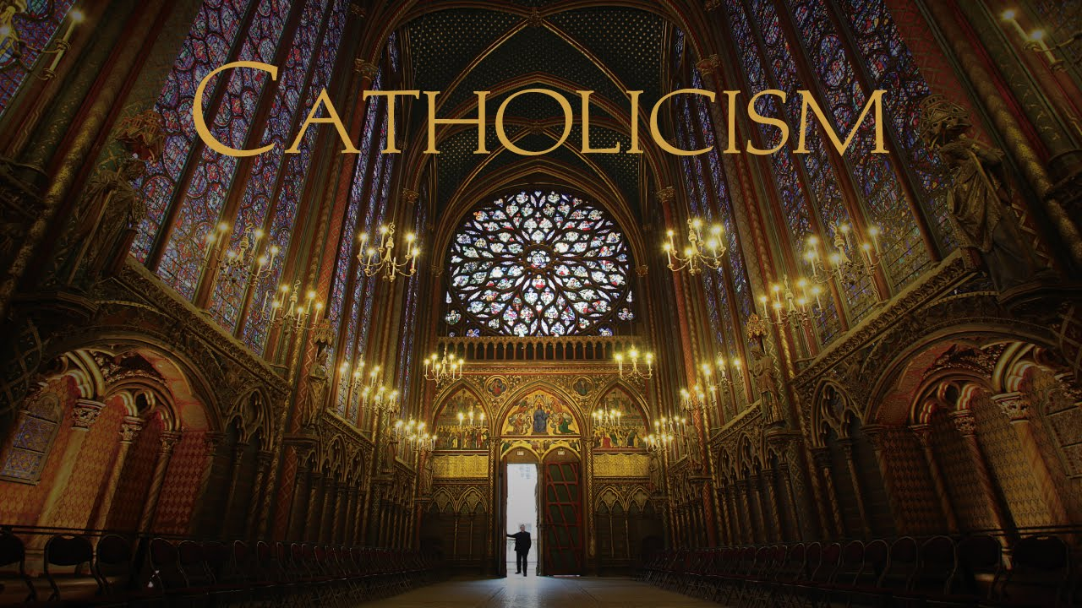
Welcome to CATHOLICISM 101: Part 3

Slide 2
Purgatory and Heaven

Slide 3
Purgatory and Heaven
Catholic Moral Teaching – the history of the Church

Slide 4
Purgatory and Heaven
Catholic Moral Teaching – the history of the Church
Being Saved

Slide 5
Purgatory and Heaven
Catholic Moral Teaching – the history of the Church
Being Saved
Hell and Heaven

Slide 6
Purgatory and Heaven
Catholic Moral Teaching – the history of the Church
Being Saved
Hell and Heaven
Purgatory

Slide 7
Purgatory and Heaven
Catholic Moral Teaching – the history of the Church
Being Saved
Hell and Heaven
Purgatory
Praying for those who have died

Slide 8
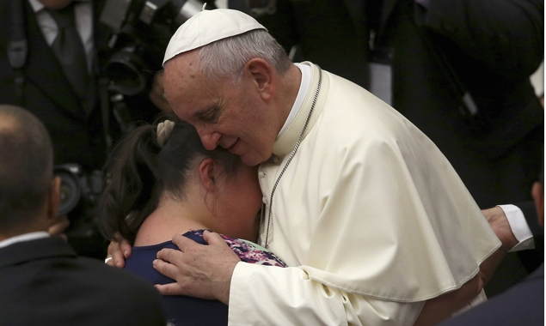
PURGATORY AND HEAVEN
Being Saved
One issue that causes differences within Christianity is the whole area of how a person is reconciled with God in life and at the time of death.

Slide 9
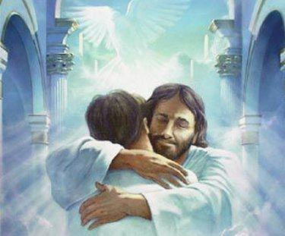
PURGATORY AND HEAVEN
Being Saved
For some Christians it is all handed over to Jesus … that we are sinners, but that the Cross at Calvary saves us….in this life and in the next.

Slide 10
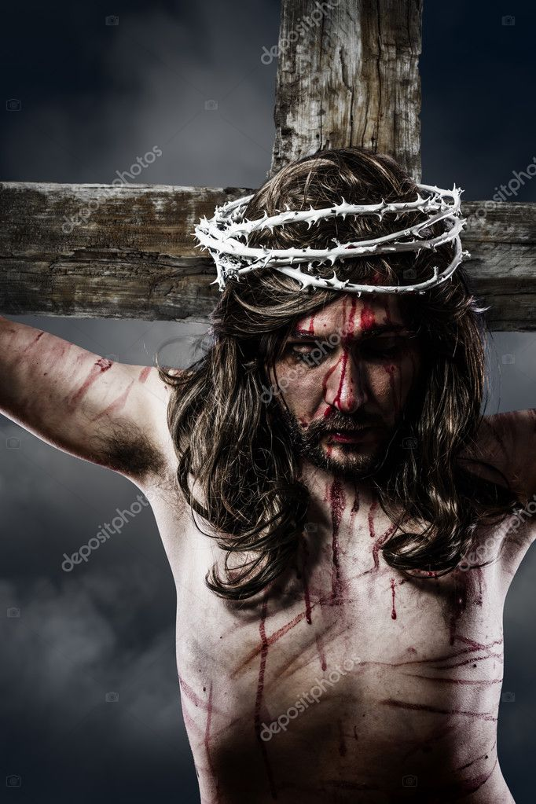
PURGATORY AND HEAVEN
Being Saved
Catholics certainly believe that Jesus, on the Cross at Calvary, is how we are saved, for our sins our now taken on by the Lamb of God …

Slide 11
PURGATORY AND HEAVEN
Being Saved
But we do add in the importance of the community helping an individual in this life and in the next (SO THAT THE CHURCH, ULTIMATELY, IS IMPORTANT TO JESUS – that we are to help one another to follow Him through our prayers and life together).

Slide 12
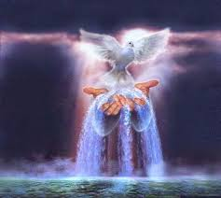
PURGATORY AND HEAVEN
Being Saved
And also that reconciling to God, after this life ends, might also entail not only that we are FORGIVEN by God, but that we are PURIFIED in the presence of God … healed.

Slide 13
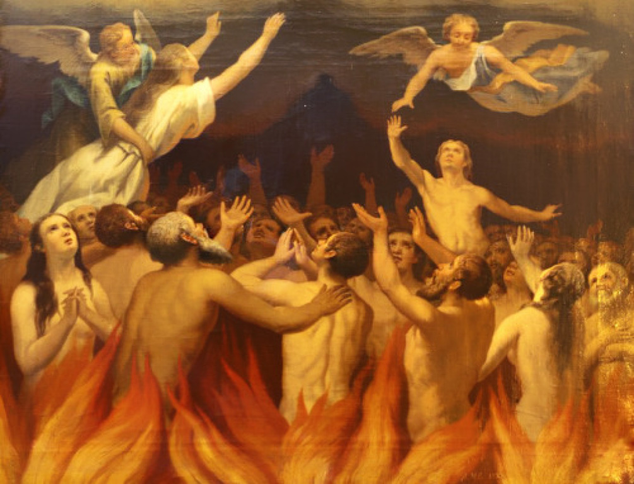
PURGATORY AND HEAVEN
Being Saved
SO we come to the topics of PRAYING FOR THOSE WHO HAVE DIED and also PURGATORY as a concept alongside Heaven and Hell.

Slide 14
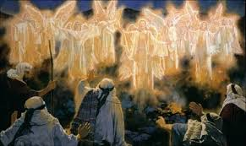
PURGATORY AND HEAVEN
First of all, when we speak about Heaven and Hell:
Heaven is to be with the love of God and all the heavenly host, and Hell is to be separated from that.

Slide 15
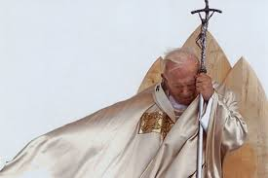
PURGATORY AND HEAVEN
First of all, when we speak about Heaven and Hell:
St. Pope John Paul II once said that hell is not necessarily a place, that it could be a state of being separated from God….and the Catechism of the Catholic Church says that the “…Main punishment of hell is eternal separation from God, in which only men can have
life and happiness for which we are created, and for which we aspire.” (CCC 631)

Slide 16
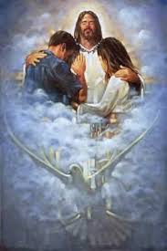
PURGATORY AND HEAVEN
First of all, when we speak about Heaven and Hell:
So Heaven is to encounter the Love of God and the heavenly host ...

Slide 17
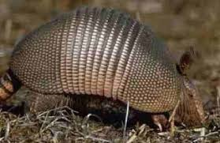
PURGATORY AND HEAVEN
First of all, when we speak about Heaven and Hell:
and Hell could be us being an armadillo and withdrawing into our shell, cut off.

Slide 18
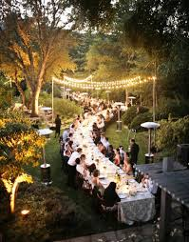
PURGATORY AND HEAVEN
First of all, when we speak about Heaven and Hell:
Jesus describes heaven as a place of communion and celebration (saying it is like a “banquet”),

Slide 19
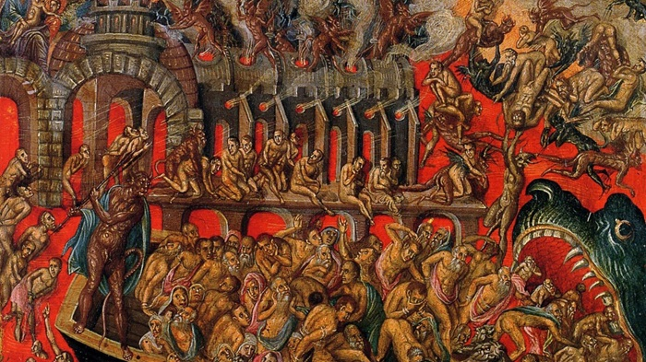
PURGATORY AND HEAVEN
First of all, when we speak about Heaven and Hell:
Jesus also uses images of “unquenchable fire” or a fiery furnace to describe hell (Mt 13:41-42),

Slide 20
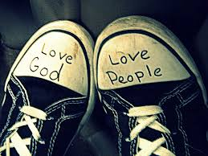
PURGATORY AND HEAVEN
First of all, when we speak about Heaven and Hell:
but the main difference between heaven and hell is the connection to GOD and the connection to OTHER PEOPLE. So that if loving God and neighbor is what following Jesus is all about, then NOT loving God or our neighbor as ourselves is how we prepare for hell.

Slide 21
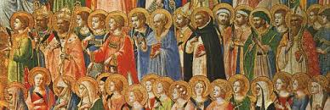
PURGATORY AND HEAVEN
First of all, when we speak about Heaven and Hell:
As far as heaven goes, the Church officially says that all the SAINTS are people that we KNOW are in heaven. The Church, on the other hand, has never definitively said that any given person is in Hell.

Slide 22
PURGATORY AND HEAVEN
Being Saved by Grace versus Works:
As far as how we guarantee our salvation: One can turn to quotes in the Bible that seem to completely contradict one another on this topic. For example, one could turn to John 3:16 to see that one is saved simply by professing faith in Jesus Christ.

Slide 23
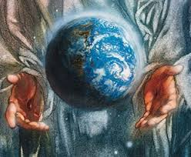
PURGATORY AND HEAVEN
Being Saved by Grace versus Works:
For God so loved the world that he gave his one and only Son, that whoever believes in him shall not perish but have eternal life.

Slide 24
PURGATORY AND HEAVEN
Being Saved by Grace versus Works:
But, on the other hand, in Matthew 7:22 we hear Jesus himself say, “Not everyone who says to Me, ‘Lord, Lord,’ will enter the kingdom of heaven, but only he who does the will of My Father in heaven.

Slide 25
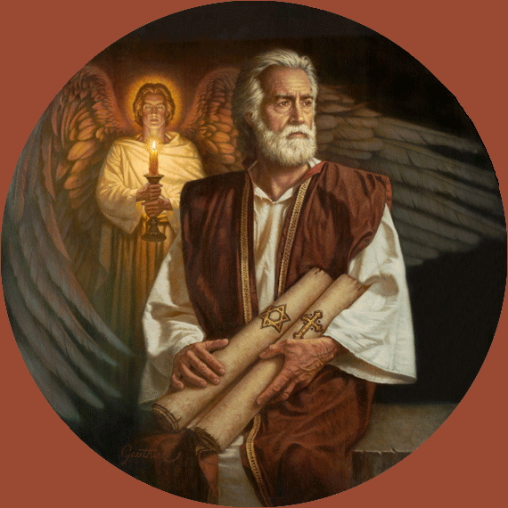
PURGATORY AND HEAVEN
Being Saved by Grace versus Works:
Many will say to Me on that day, ‘Lord, Lord, did we not prophesy in Your name, and in Your name drive out demons and perform many miracles?’ Then I will tell them plainly, ‘I never knew you; depart from Me, you workers of lawlessness’ …

Slide 26
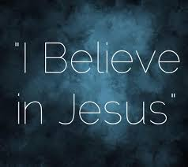
PURGATORY AND HEAVEN
Being Saved by Grace versus Works:
Now, how could someone who prophesy in Jesus’s name and drive out demons and perform many miracles never have gotten around to saying to Jesus in their heart, at least once, “I believe in you Jesus”? How is that possible?

Slide 27
PURGATORY AND HEAVEN
Being Saved by Grace versus Works:
The answer is that Jesus is saying you may, indeed, say you believe … but how you live your life could mean you are not saved.

Slide 28
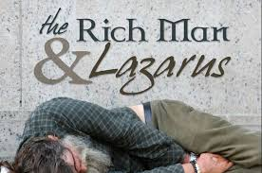
PURGATORY AND HEAVEN
Being Saved by Grace versus Works:
Consider the story of Lazarus the poor man, where a rich man, who obviously was an observant, religious person, ends up “in torment” because of how he ignored the sufferings of Lazarus the poor man (Luke 16:19-31).

Slide 29
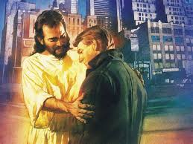
PURGATORY AND HEAVEN
Being Saved by Grace versus Works:
We also know that Jesus is very forgiving, often of those that everyone else in society wants to reject or hate

Slide 30
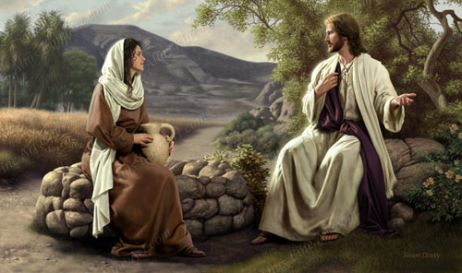
PURGATORY AND HEAVEN
Being Saved by Grace versus Works:
We also know that Jesus is very forgiving, often of those that everyone else in society wants to reject or hate
The woman at the well

Slide 31
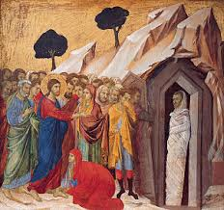
PURGATORY AND HEAVEN
Being Saved by Grace versus Works:
We also know that Jesus is very forgiving, often of those that everyone else in society wants to reject or hate
The woman at the well
Mary, the sister of Lazarus

Slide 32
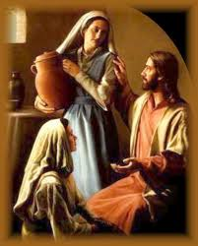
PURGATORY AND HEAVEN
Being Saved by Grace versus Works:
We also know that Jesus is very forgiving, often of those that everyone else in society wants to reject or hate
The woman at the well
Mary, the sister of Lazarus
Martha

Slide 33
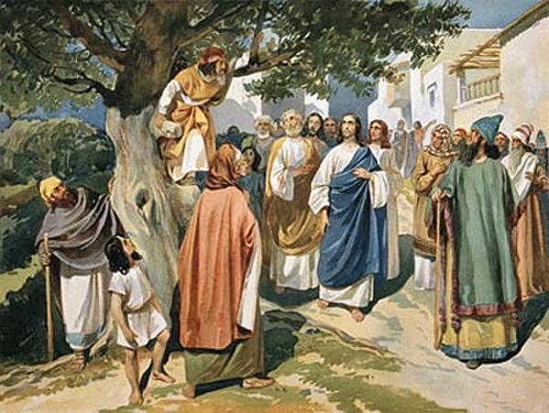
PURGATORY AND HEAVEN
Being Saved by Grace versus Works:
We also know that Jesus is very forgiving, often of those that everyone else in society wants to reject or hate
The woman at the well
Mary, the sister of Lazarus
Martha
Zacchaeus the tax collector

Slide 34
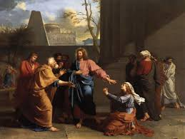
PURGATORY AND HEAVEN
Being Saved by Grace versus Works:
We also know that Jesus is very forgiving, often of those that everyone else in society wants to reject or hate
The woman at the well
Mary, the sister of Lazarus
Martha
Zacchaeus the tax collector
The woman caught in adultery

Slide 35
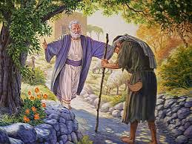
PURGATORY AND HEAVEN
Being Saved by Grace versus Works:
he describes, in the story of the Prodigal Son, an amazingly loving God who RUNS to embrace his son when he returns home to ask for forgiveness …

Slide 36
PURGATORY AND HEAVEN
Being Saved by Grace versus Works:
So we should never fear our loving God … but we also don’t want to live out something untrue. That somehow, if we just believe in Jesus, we are fine no matter how we treat others – indeed, look at Matthew 25 or 1 John 4:20 or many other places in Scripture to see that this is true.

Slide 37
PURGATORY AND HEAVEN
Being Saved by Grace versus Works:
So the notion, in some segments of Christianity (not Catholics) that we are simply saved by grace and accepting Jesus, and that our actions have nothing to do with our salvation, is not Biblical.

Slide 38
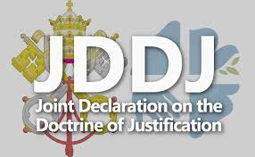
PURGATORY AND HEAVEN
Being Saved by Grace versus Works:
What are we to think though? Well, I do believe the answer comes in the 1999 Lutheran-Catholic declaration on the Doctrine of Justification (how we are saved).

Slide 39
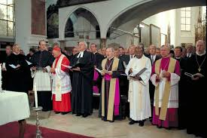
PURGATORY AND HEAVEN
Being Saved by Grace versus Works:
This was put together by leaders of the Roman Catholic Church and the World Lutheran Federation at the very highest levels.

Slide 40
PURGATORY AND HEAVEN
Being Saved by Grace versus Works:
And it said that we are SAVED BY THE FREE GIFT OF GRACE FROM GOD – not by piling up good works for God

Slide 41
PURGATORY AND HEAVEN
Being Saved by Grace versus Works:
... BUT, that if we really have professed to believe in our Savior, Jesus, and truly profess his name, THEN OUR ACTIONS SHOULD REFLECT THAT FAITH IN JESUS ... and if they do not, then they are just empty words.

Slide 42
PURGATORY AND HEAVEN
Being Saved by Grace versus Works:
Indeed, maybe 1 John 4:20 helps us to see this when we quote that Scripture:

Slide 43
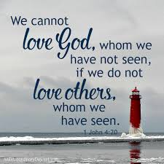
PURGATORY AND HEAVEN
Being Saved by Grace versus Works:
Whoever claims to love God yet hates a brother or sister is a liar. For whoever does not love their brother and sister, whom they have seen, cannot love God, whom they have not seen.

Slide 44
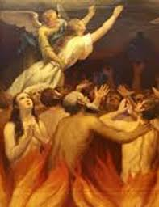
PURGATORY
Belief of Purgatory in the Catholic faith
This is the Catholic belief that there might be a process of being PURIFIED after we die ...

Slide 45
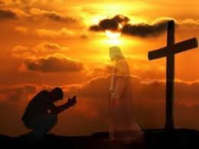
PURGATORY
Belief of Purgatory in the Catholic faith
... that while God is a forgiving God ... and we know that if we sincerely turn to God with a contrite heart, any of us can be forgiven any time ... that there might be a process of purification for folks after they die for any number of reasons.

Slide 46
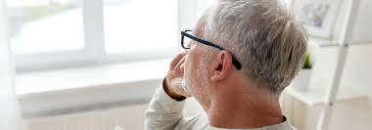
PURGATORY
Belief of Purgatory in the Catholic faith
To me this idea makes sense. And it actually is a compassionate idea in my mind. For example, consider the people of this world who might have died in confusion ... never knowing real love perhaps in a terrible situation as a child … confused and hurt ... or dying full of confusion as an adult.

Slide 47
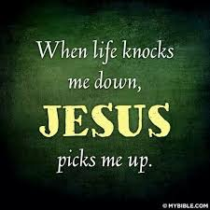
PURGATORY
Belief of Purgatory in the Catholic faith
I would think that even if these people could not “claim Jesus as their Savior and ask for forgiveness” at their deathbed, that Jesus would want to “work on them” after this life was over ... to heal them ...

Slide 48
PURGATORY
Belief of Purgatory in the Catholic faith
And this is what we would say could happen if we believe in Purgatory: That faith in God is not a “simple yes or no” at death … but one where God reads the heart … even the heart that can’t express anything but hurt or pain at death.

Slide 49
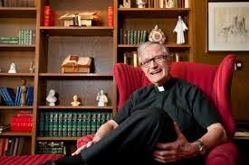
PURGATORY
Belief of Purgatory in the Catholic faith
Indeed, Fr. Joe Breighner once wrote: "I don't think of purgatory as purging by a mean God, as much as I think of it as another birthing process.

Slide 50
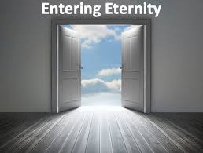
PURGATORY
Belief of Purgatory in the Catholic faith
Just as we enter this world, messy and crying, no doubt something of our earthly past clings to us as we enter eternity.

Slide 51
PURGATORY
Belief of Purgatory in the Catholic faith
Being cleansed of past sins, past selfishness -- things rooted in earth -- is simply a process necessary to fully experience the presence of God.

Slide 52
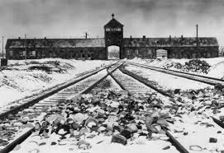
PURGATORY
Belief of Purgatory in the Catholic faith
Now also consider another example: The true story of a Nazi SS commander at Auschwitz who, weeks after the liberation of that camp where 1.5 million men, women, children and babies were murdered and tortured,

Slide 53
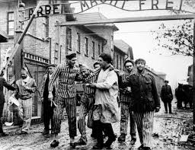
PURGATORY
Belief of Purgatory in the Catholic faith
this SS commander, who personally did horrible things to many people there for years. Weeks after the camp was closed …

Slide 54
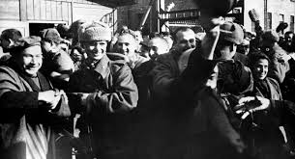
PURGATORY
Belief of Purgatory in the Catholic faith
this SS commander, who personally did horrible things to many people there for years. Weeks after the camp was closed …

Slide 55
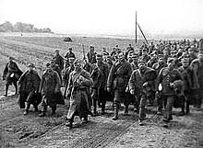
PURGATORY
Belief of Purgatory in the Catholic faith
in the midst of the confusion of the Russian advance through Poland, realized he was dying of some condition, and having been brought up a Catholic before embracing Nazism, now was wanting the Last Rites before dying.

Slide 56
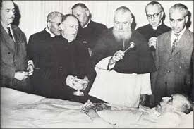
PURGATORY
Belief of Purgatory in the Catholic faith
So he sent word out to the Polish Catholic priests in the area (he was still living in Poland at that time) asking for Last Rites. For several days he only got “no’s” from the local priests….till finally a Jesuit agreed to pray with him before death.

Slide 57
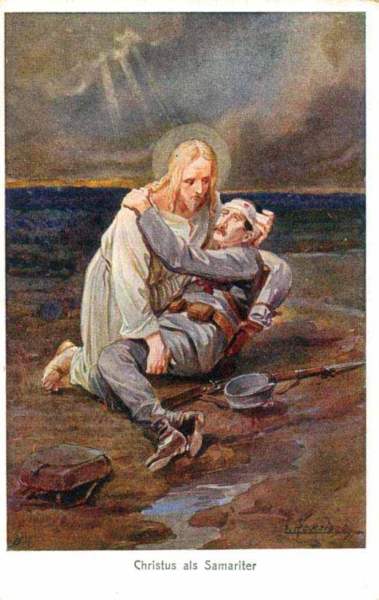
PURGATORY
Belief of Purgatory in the Catholic faith
Now, yes Jesus can forgive his sins, and in the thinking of some Christian groups that is ALL THAT THERE IS to our being ready to “join the heavenly banquet” – that we say we’re sorry and Jesus forgives us and wipes away our sins.

Slide 58
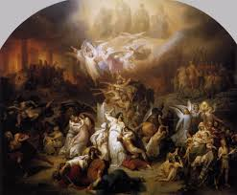
PURGATORY
Belief of Purgatory in the Catholic faith
But does it make sense that this man, who had personally done undiscussable things to other human beings for years, and who had been so immersed in evil for so many years ... does it make sense that, even forgiven, this man would need to go through a process of purification in heaven?

Slide 59
PURGATORY
Belief of Purgatory in the Catholic faith
Doesn’t it make sense that he would need to do SOMETHING to atone/heal/be totally filled with Christ?

Slide 60
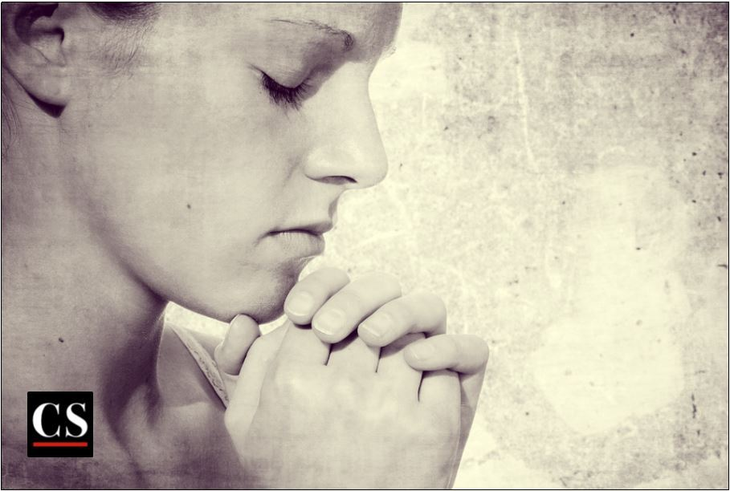
PRAYING FOR THOSE WHO HAVE DIED
The Cross at Calvary is Assisted by the Community
Again, we know that Christ’s cross takes away our sins ... but from a Catholic point-of-view, we simply know that any Christian KNOWS to pray for friends and family in their journey of following Christ.

Slide 61
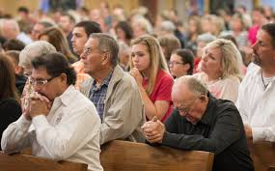
PRAYING FOR THOSE WHO HAVE DIED
The Cross at Calvary is Assisted by the Community
… and so we just do that as a CHURCH for people who are on earth, and also those who have gone on to the next life.

Slide 62
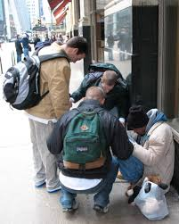
PRAYING FOR THOSE WHO HAVE DIED
The Cross at Calvary is Assisted by the Community
So WE pray for one another in this life (for our family, friends, those in need, individually and through the Church….)

Slide 63
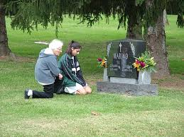
PRAYING FOR THOSE WHO HAVE DIED
The Cross at Calvary is Assisted by the Community
and the same for those who have died

Slide 64
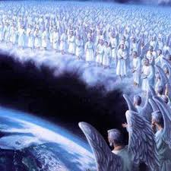
PRAYING FOR THOSE WHO HAVE DIED
The Cross at Calvary is Assisted by the Community
... and we believe that those in Heaven, those who have gone before us, ALSO pray for us ... just as any Christian of any kind would know to pray for family and friends and those in need.

Slide 65
PRAYING FOR THOSE WHO HAVE DIED
The Cross at Calvary is Assisted by the Community
It’s A PRETTY STRAIGHTFORWARD AND SIMPLE NOTION ... AND DOESN’T TAKE AWAY THE SALVATION THAT COMES FROM JESUS.

Slide 66
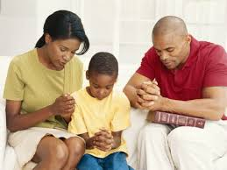
PRAYING FOR THOSE WHO HAVE DIED
The Cross at Calvary is Assisted by the Community
... BUT SIMPLY THAT WE BELIEVE IN THE POWER OF PRAYER TO ASSIST THE LORD IN HIS WORK, the same way any Christian mom or dad prays for their children in this world.

Slide 67
PRAYING FOR THOSE WHO HAVE DIED
The Cross at Calvary is Assisted by the Community
We pray ... and as we heard earlier in Revelation 6:9 says: When the Lamb broke the fifth seal, I saw underneath the altar the souls of those who had been slain because of the word of God, and because of the testimony which they had maintained

Slide 68
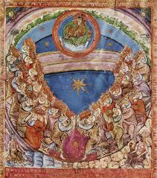
PRAYING FOR THOSE WHO HAVE DIED
The Cross at Calvary is Assisted by the Community
so the martyrs in heaven are UNDERNEATH the altar of God in heaven ... assisting the Lord in his work.

Slide 69
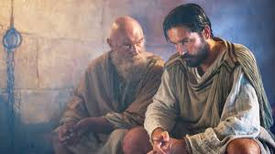
PRAYING FOR THOSE WHO HAVE DIED
The Cross at Calvary is Assisted by the Community
St. Paul prays for a fellow Christian, that they have God’s mercy in 2 Timothy 1: 16-18: May the Lord grant mercy to the household of Onesiphorus … may the Lord grant him to find mercy from the Lord on that Day …

Slide 70
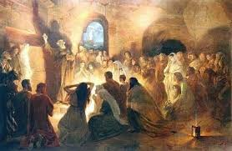
PRAYING FOR THOSE WHO HAVE DIED
The Cross at Calvary is Assisted by the Community
But even beyond these Scripture quotes ... let’s remember, again, the whole mindset, which we see among the most ancient of Christians, of NOT BEING LONERS IN FOLLOWING JESUS …

Slide 71
PRAYING FOR THOSE WHO HAVE DIED
The Cross at Calvary is Assisted by the Community
... but that that they were always a family that prayed for one another and lived out their faith TOGETHER.

Slide 72
PRAYING FOR THOSE WHO HAVE DIED
The Cross at Calvary is Assisted by the Community
We know the Lord saves us, but we also know that even the Lord asked for the help and prayers of the disciples when he was in the Garden of Gethsemane …

Slide 73
PRAYING FOR THOSE WHO HAVE DIED
The Cross at Calvary is Assisted by the Community
so we PRAY FOR THE WORK OF OUR LORD NOW….offering our own prayers to help the Lord in his work on behalf of those who need God’s healing.

Slide 74
SACRAMENTS
Having just talked about the idea of COMMUNITY in the teachings of our Savior ... how he intended for there to be a CHURCH from the beginning ... a family ... not just a collection of loner disciples who approached him individually.

Slide 75
SACRAMENTS
this is a great segway into talking a bit on SACRAMENTS.

Slide 76
SACRAMENTS
Sacraments are actions in the life of the Church that always involve groups of people PRAYING TOGETHER…..

Slide 77
SACRAMENTS
We pray for a baby at baptism

Slide 78
SACRAMENTS
We pray for a baby at baptism
We pray for 2nd graders as they go to first communion

Slide 79
SACRAMENTS
We pray for a baby at baptism
We pray for 2nd graders as they go to first communion
We pray for our high school students when they are getting confirmed

Slide 80
SACRAMENTS
We pray for a baby at baptism
We pray for 2nd graders as they go to first communion
We pray for our high school students when they are getting confirmed
We pray for the sick

Slide 81
SACRAMENTS
We pray for a baby at baptism
We pray for 2nd graders as they go to first communion
We pray for our high school students when they are getting confirmed
We pray for the sick
We pray for someone turning over a new leaf in confession

Slide 82
SACRAMENTS
Sacraments are times when the COMMUNITY OF FAITH/THE CHURCH, that Jesus started and wanted to be part of our spiritual lives, gathers to pray in certain ways ...

Slide 83
SACRAMENTS
St. Augustine, in the 4th century, once famously wrote that sacraments are “visible signs of invisible grace.” Which gives us a glimpse into maybe WHY Jesus wanted there to be a CHURCH.

Slide 84
SACRAMENTS
If our glimpses of heaven are any indication, certainly in Heaven they PRAY together and have a VISIBLE sign for all in heaven through their shared praise of God and prayers together.

Slide 85
SACRAMENTS
The Church exists to help people to experience God ... with a little bit of help ... through the gift of the Eucharist so we can see God in the palm of our hand

Slide 86
SACRAMENTS
Or in the words of the priest that (hopefully) express the love of God and forgiveness of God in confession.

Slide 87
SACRAMENTS
Or in the Oil of the Sick and the prayers and the laying on of hands in the Sacrament of the Sick.

Slide 88
SACRAMENTS
Indeed, if one confesses ones sins all alone, sincerely, we are forgiven ... but then again, all we usually hear is the churning silence when we do that

Slide 89
SACRAMENTS
So a Sacrament offers (to quote St. Augustine again and to paraphrase him) “visible and audible” signs of God’s grace ... and even that God is now offered to us in the scented oil or incense or the taste of bread and wine ...

Slide 90
SACRAMENTS
God’s grace is always available to everyone, everywhere, but we believe that it was Jesus’s intention that the Church offer people some help in finding and experience that grace ... and one way we think the Church does that is through sacraments.

Slide 91
SACRAMENTS
There are also seven official sacraments of Church, of the faith community. They are all communal prayer forms.

Slide 92
SACRAMENTS
In their communal prayer, Catholics like a lot of singing, oil, fire, water, chanting, sitting and standing -- experiencing -- the more the better.

Slide 93
SACRAMENTS
Why?

Slide 94
SACRAMENTS
Not because these things tell us what to do like the points, ideas and arguments of a good, logical homily or sermon.

Slide 95
SACRAMENTS
… but because, people’s lives are changed when they gather in with reverence and without rushing.

Slide 96
SACRAMENTS
So we shake our hands with our neighbors, not our fists at them, and we get new images from scripture and our brothers and sisters that help us to glimpse into the way we will live in the Kingdom, where Jesus is the first born.

Slide 97
SACRAMENTS
To remember we have dignity, and to offer that freedom and dignity to all the world.

Slide 98
SACRAMENTS
The seven Sacraments:

Slide 99
SACRAMENTS
The seven Sacraments:
Baptism

Slide 100
SACRAMENTS
The seven Sacraments:
Baptism
Confirmation

Slide 101
SACRAMENTS
The seven Sacraments:
Baptism
Confirmation
The Eucharist: The Source and summit of our faith

Slide 102
SACRAMENTS
The seven Sacraments:
Baptism
Confirmation
The Eucharist: The Source and summit of our faith
Sacrament of Reconciliation

Slide 103
SACRAMENTS
The seven Sacraments:
Baptism
Confirmation
The Eucharist: The Source and summit of our faith
Sacrament of Reconciliation
Anointing of the Sick

Slide 104
SACRAMENTS
The seven Sacraments:
Baptism
Confirmation
The Eucharist: The Source and summit of our faith
Sacrament of Reconciliation
Anointing of the Sick
Holy Orders

Slide 105
SACRAMENTS
The seven Sacraments:
Baptism
Confirmation
The Eucharist: The Source and summit of our faith
Sacrament of Reconciliation
Anointing of the Sick
Holy Orders
Marriage

Slide 106
THE HISTORY OF THE CHURCH
There is no way to truly cover the history of the Church at this time with any real effectiveness ... but here are some brief points:

Slide 107
THE HISTORY OF THE CHURCH
Who started the Church?

Slide 108
THE HISTORY OF THE CHURCH
Who started the Church?
Jesus did.

Slide 109
THE HISTORY OF THE CHURCH
In Matthew 16 and 18 he declares that he wants this Church to be started with St. Peter as the head….and that this Church will exist until he returns in glory.

Slide 110
THE HISTORY OF THE CHURCH
In John 20 he breathes the Holy Spirit upon ALL the apostles and tells them they have a special role in leading this, in Jesus’s mind, important community … the Church.

Slide 111
THE HISTORY OF THE CHURCH
And in Matthew 28 he gives the apostles the job to bring all nations and peoples into the Church through baptism.

Slide 112
THE HISTORY OF THE CHURCH
The Church, at the very beginning, celebrates mass every day, listens to Scripture together every day, and is so committed to the idea of being a community (not just a collection of people that all have an individual or private relationship with Jesus).

Slide 113
THE HISTORY OF THE CHURCH
They even hold all of their possessions in common (Acts of the Apostles, chapter 2). All the members of the Church also have the gift of the Holy Spirit personally (Acts 2).

Slide 114
THE HISTORY OF THE CHURCH
The Church, from the beginning, wants to be united as one and to be united in belief (illustrated, as we have previously mentioned, in Acts 15 where a disagreement about how to handle converts from outside of Judaism was handled with the assumption that they would remain united in faith as one Church).

Slide 115
THE HISTORY OF THE CHURCH
The Church had deacons, bishops and priests by the time of the writing of the New Testament (mentioned earlier, re: 1 Timothy 3, etc.)

Slide 116
THE HISTORY OF THE CHURCH
The Church focused, from the beginning, on the Bishop of Rome being a successor to St. Peter, who represented the UNITY of the whole Church. (also previously mentioned.)

Slide 117
THE HISTORY OF THE CHURCH
The early mass developed very quickly. This was also mentioned earlier, but here is an interesting description, from 155AD, of a Sunday mass:

Slide 118
THE HISTORY OF THE CHURCH
From the First Apology of St. Justin Martyr, c. 155 AD
“ No one may share the Eucharist with us unless he believes that what we teach is true, unless he is washed in the regenerating waters of baptism for the remission of his sins, and unless he lives in accordance with the principles given us by Christ.

Slide 119
THE HISTORY OF THE CHURCH
We do not consume the Eucharistic bread and wine as if it were ordinary food and drink, for we have been taught that as Jesus Christ our Savior became a man of flesh and blood by the power of the Word of God, so also the food that our flesh and blood assimilates for its nourishment becomes the flesh and blood of the incarnate Jesus by the power of his own words contained in the prayer of thanksgiving.

Slide 120
THE HISTORY OF THE CHURCH
The apostles, in their recollections, which are called gospels, handed down to us what Jesus commanded them to do.

Slide 121
THE HISTORY OF THE CHURCH
They tell us that he took bread, gave thanks and said: Do this in memory of me. This is my body. In the same way he took the cup, he gave thanks and said: This is my blood.

Slide 122
THE HISTORY OF THE CHURCH
The Lord gave this command to them alone. Ever since then we have constantly reminded one another of these things.

Slide 123
THE HISTORY OF THE CHURCH
The rich among us help the poor and we are always united. For all that we receive we praise the Creator of the universe through his Son Jesus Christ and through the Holy Spirit.

Slide 124
THE HISTORY OF THE CHURCH
On Sunday we have a common assembly of all our members, whether they live in the city or the outlying districts.

Slide 125
THE HISTORY OF THE CHURCH
The recollections of the apostles or the writings of the prophets are read, as long as there is time. When the reader has finished, the president of the assembly speaks to us; he urges everyone to imitate the examples of virtue we have heard in the readings. Then we all stand up together and pray.

Slide 126
THE HISTORY OF THE CHURCH
On the conclusion of our prayer, bread and wine and water are brought forward.

Slide 127
THE HISTORY OF THE CHURCH
The president offers prayers and gives thanks to the best of his ability, and the people give assent by saying, “Amen”.

Slide 128
THE HISTORY OF THE CHURCH
The Eucharist is distributed, everyone present communicates, and the deacons take it to those who are absent.

Slide 129
THE HISTORY OF THE CHURCH
The wealthy, if they wish, may make a contribution, and they themselves decide the amount. The collection is placed in the custody of the president, who uses it to help the orphans and widows and all who for any reason are in distress, whether because they are sick, in prison, or away from home. In a word, he takes care of all who are in need.

Slide 130
THE HISTORY OF THE CHURCH
We hold our common assembly on Sunday because it is the first day of the week, the day on which God put darkness and chaos to flight and created the world, and because on that same day our savior Jesus Christ rose from the dead. For he was crucified on Friday and on Sunday he appeared to his apostles and disciples and taught them the things that we have passed on for your consideration.“

Slide 131
THE HISTORY OF THE CHURCH
Acts 15, where St. Peter and St. Paul and all of the early leaders of the Church gathered, is considered to be THE FIRST CHURCH COUNCIL ... that is, a gathering of the leaders of the Church to make decisions and to deal with issues.

Slide 132
THE HISTORY OF THE CHURCH
Other councils have happened through the history of the Church and they are considered to be VERY important in the life of the Church. Through these councils we defined our beliefs about Jesus being human and divine, the Trinity, etc.

Slide 133
THE HISTORY OF THE CHURCH
Also at the Council of Nicea in 325 AD we produced “the Creed” which is still said at Sunday and Holy Day masses and is our overall belief statement.

Slide 134
THE HISTORY OF THE CHURCH
Further, councils in the 300’s and 400’s set the list of books in our Bible today, dealt with reforms of the Church after the Reformation (Trent in the 1500’s) and also how to deal with the modern world/ecumenism/liturgical changes/other at the Second Vatican Council, which ended in the mid-1960’s.

Slide 135
THE HISTORY OF THE CHURCH
After Christianity was legalized by the Roman Empire in 312AD, it actually caused a NEW crisis for, whereas for 300 years the Church had been poor and marginalized and only adhered to by the most devout and courageous due to the persecution (and about 10% of the Roman Empire was Christian in 312AD),

Slide 136
THE HISTORY OF THE CHURCH
Soon EVERYONE was becoming Christian and it became the social norm ... when that happened many Christians felt that the Church lost some of it’s former moral strength. BECAUSE OF THIS the first monastic communities, for men and women, developed.

Slide 137
THE HISTORY OF THE CHURCH
First in Egypt in the 300’s (St. Anthony of the Desert) and then in the West by 500AD (St. Benedict in Italy).

Slide 138
THE HISTORY OF THE CHURCH
These men and women referred to their renouncing of marriage in celibacy, of material things and of giving all to Christ as “the new martyrdom.”

Slide 139
THE HISTORY OF THE CHURCH
With the collapse of the Western Roman Empire (476 AD) many new peoples move in to Europe. There is a slow process of Christianizing Europe that is not complete until the conversion of the Lithuanians in 1387. The Poles converted around 966, the Hungarians around the year 1000.

Slide 140
THE HISTORY OF THE CHURCH
Monasteries, many founded by Irish Monks, protected the last copies of many of the ancient classics of Greece, Rome and the Ancient era. These monasteries also became the places where the first universities were organized at Bologna (1088), Paris (1150), etc.

Slide 141
THE HISTORY OF THE CHURCH
Islam overwhelms over half of Christendom between 632 and 750 – including Spain, north Africa, the ancient Near East and the Caucuses.

Slide 142
THE HISTORY OF THE CHURCH
The Christians in Greek-speaking areas break off from the Christians of Western Europe in a “schism” in 1054. From Rome and Constantinople (now Istanbul) there are mutual excommunications. These are only lifted in 1964. Eastern churches, generally, allow married parish priests (though bishops must be celibate).

Slide 143
THE HISTORY OF THE CHURCH
In the 11th century there is a conflict between Pope Gregory VII and a secular Emperor. It had to do with who got the power to name bishops and therefore control Church affairs (the Church or the local secular ruler.)

Slide 144
THE HISTORY OF THE CHURCH
At this time the Catholic Church is very weak and there are problems because local authorities sometimes name relatives/friends/etc. to certain Church positions because they are money-making etc.

Slide 145
THE HISTORY OF THE CHURCH
In the end the Church asserts control over these matters. This strengthens the Church, but also leads to corruption in the Church: As the Church now has much greater power and, eventually, much greater wealth.

Slide 146
THE HISTORY OF THE CHURCH
There are many wonderful renewal movements in the Church at this time (Franciscans, Dominicans), but also an ongoing problem with corruption in the Church

Slide 147
THE HISTORY OF THE CHURCH
Clergy who were not sufficiently educated in the faith (local towns often had priests whose only education was that they learned to say the mass in Latin from another priest ... seminaries were only organized, with rigorous educational standards, after the Reformation.)

Slide 148
THE HISTORY OF THE CHURCH
The Crusades began in 1095 and ended in 1291.

Slide 149
THE HISTORY OF THE CHURCH
Initially they began when access to Jerusalem was denied to Christians. While any killing in the name of religion is wrong, it is worthwhile to note that at their apex, Christian crusaders had only taken back a token segment of the many nations, once Christian, which had been taken over by Muslim armies from 632

Slide 150
THE HISTORY OF THE CHURCH
up to this point and where Christians had either been forced to flee, to convert, or to live as second-class citizens/pay extra taxes/live in guettos, etc. I am not trying to be an apologist here, but it is simply fair enough to point out.

Slide 151
THE HISTORY OF THE CHURCH
Around the year 1350, 30-60% of Europe’s population dies because of the Black Death. This is a time of great upheaval in Europe and it contributes to an increase in hysterical behavior in Europe such as the persecution of Jewish people or witch trials. These activities happen in both Catholic and Protestant areas of Europe after the Reformation as well.

Slide 152
THE HISTORY OF THE CHURCH
In 1517 a German monk, Martin Luther, publically disputes Church actions. Eventually he leaves the Church.

Slide 153
THE HISTORY OF THE CHURCH
This is the beginning of the Reformation.

Slide 154
THE HISTORY OF THE CHURCH
In response, the Catholic Church goes through a real purification at this time; and a real flowering of true Gospel conversion and fervor.

Slide 155
THE HISTORY OF THE CHURCH
Reforms are made of the mass, in the training of priests, and many “new” movements (like the Jesuits) blossom.

Slide 156
THE HISTORY OF THE CHURCH
In the subsequent revival of the Church, called “The Counter-Reformation” we have some of the very best generations of Church leadership.

Slide 157
THE HISTORY OF THE CHURCH
As an example of the energy in the Church at this time, during the 16th and 17th centuries, Catholic missionaries fan out all over North and South America, Africa and Asia – even as far as Japan, China and the South Pacific.

Slide 158
THE HISTORY OF THE CHURCH
But it is only in the 18th century that Protestant groups in Europe begin to do similar missionary expeditions.

Slide 159
THE HISTORY OF THE CHURCH
Europe is now dealing with a much more rigorous intellectual milieu, and one that, more and more, sees itself as independent of the Church or tradition.

Slide 160
THE HISTORY OF THE CHURCH
In the “Enlightenment” – 1650-1800, many philosophers come forward with thinking that directly challenges people of faith.

Slide 161
THE HISTORY OF THE CHURCH
One philosopher, Emmanuel Kant, basically writes that there is no way to prove or to disprove belief in God….which means that God is, essentially, something that belongs to A PERSON’S PRIVATE LIFE. This privatization of religion in Western society, so that we go from having village Feast Days to arguments about being able to mention God in our schools, has a genesis in this era.

Slide 162
THE HISTORY OF THE CHURCH
In the 19th century, some scientific studies like Darwin and political theories, like atheistic Marxism, that offer more challenges to the Church.

Slide 163
THE HISTORY OF THE CHURCH
The Church responds, in the modern era, in two ways. One is to bring in more use of psychology, social sciences, political ideas into Church thinking ... so that, for example, we now believe in all faiths having freedom in each society …. etc. (that came from Vatican II)

Slide 164
THE HISTORY OF THE CHURCH
That we no longer believe that suicide leads to a person going automatically to Hell (again, from Vatican II era – leads to change from 1917 to 1983 Canon Law Code.)

Slide 165
THE HISTORY OF THE CHURCH
THE OTHER WAY the Church responds is the 1870 Infallibility statement, which was discussed in detail in the last class.

Slide 166
THE HISTORY OF THE CHURCH
In the most recent era of the Church, since the second Vatican Council (1962-1965), has been marked by an amazing growth of the Church OUTSIDE of Europe – especially in Africa and Asia

Slide 167
THE HISTORY OF THE CHURCH
By a modern emphasis on the mission of the laity; and by the “New Evangelization” since the year 2000, where the Church, especially in Industrialized nations, is being challenged to put itself BACK into the missionary stance in long-Christian societies, due to the challenges of secularization, etc.

Slide 168
CATHOLIC MORAL TEACHING
A basic thumbnail sketch of what Catholics say is moral and why. Starts with the bottom line of:

Slide 169
CATHOLIC MORAL TEACHING
A basic thumbnail sketch of what Catholics say is moral and why. Starts with the bottom line of:
Every person has value because they are made by God.

Slide 170
CATHOLIC MORAL TEACHING
A basic thumbnail sketch of what Catholics say is moral and why. Starts with the bottom line of:
Every person has value because they are made by God.
The larger community has a responsibility to the vulnerable.

Slide 171
CATHOLIC MORAL TEACHING
THE SOURCES OF CATHOLIC BELIEFS ABOUT WHAT IS MORAL:
THE BIBLE
Every person is “made in the image of God” and so worthy of love and respect. So too, all creation is to be treated as a gift and respected.

Slide 172
CATHOLIC MORAL TEACHING
THE SOURCES OF CATHOLIC BELIEFS ABOUT WHAT IS MORAL:
THE BIBLE
The Bible tells us to avoid certain sins (Ten commandments of Ex 20:1-17.)

Slide 173
CATHOLIC MORAL TEACHING
THE SOURCES OF CATHOLIC BELIEFS ABOUT WHAT IS MORAL:
THE BIBLE
The Bible also says that we NEED TO HELP OTHERS WHO ARE IN TROUBLE. So, the Bible tells us to “Protect widows and orphans” (or the weak) – Ez 22:22.

Slide 174
CATHOLIC MORAL TEACHING
THE SOURCES OF CATHOLIC BELIEFS ABOUT WHAT IS MORAL:
THE BIBLE
Christians model their lives on what Christ did and said. So reading the Bible is central to having a CHRISTIAN MORALITY. Jesus said for us to love God and neighbor (Luke 10:27); and Christ promised us that the Holy Spirit would
help us to love God and neighbor. commandment to love (Jn 14:26).

Slide 175
CATHOLIC MORAL TEACHING
THE SOURCES OF CATHOLIC BELIEFS ABOUT WHAT IS MORAL:
TRADITION (TEACHING OF THE CHURCH)
Catholics would say that the Holy Spirit has never stopped working in our midst, so we would see that the Holy Spirit can speak through the Church Councils,
... not just the New Testament-era members of the Church. Note: The Bible never claims that it should be the only source of teaching for Christians.

Slide 176
CATHOLIC MORAL TEACHING
THE SOURCES OF CATHOLIC BELIEFS ABOUT WHAT IS MORAL:
TRADITION (TEACHING OF THE CHURCH)
Catholics would say that Jesus did not spell out every answer to every moral problem, but in the tradition of the Church, his teaching can be approached
in a living and vital way precisely because Jesus is with the believing community in Spirit (Mt 28:20.)

Slide 177
CATHOLIC MORAL TEACHING
THE SOURCES OF CATHOLIC BELIEFS ABOUT WHAT IS MORAL:
TRADITION (TEACHING OF THE CHURCH)
A document from the Second Vatican Council (1958-1965) called “The Dogmatic Constitution on Divine Revelation” says: Sacred tradition,
Sacred Scripture, and the teaching authority of the Church

Slide 178
CATHOLIC MORAL TEACHING
THE SOURCES OF CATHOLIC BELIEFS ABOUT WHAT IS MORAL:
TRADITION (TEACHING OF THE CHURCH)
…. are all so linked and joined together that one cannot stand up without the others”. (no.10)

Slide 179
CATHOLIC MORAL TEACHING
THE SOURCES OF CATHOLIC BELIEFS ABOUT WHAT IS MORAL:
TRADITION (TEACHING OF THE CHURCH)
There are different levels of importance to different Church teachings:
The most important teachings are those from the Church Councils.
There have been many councils in the history of the Church. The first is recorded in the Bible: The Council of Jerusalem.

Slide 180
CATHOLIC MORAL TEACHING
THE SOURCES OF CATHOLIC BELIEFS ABOUT WHAT IS MORAL:
TRADITION (TEACHING OF THE CHURCH)
There are different levels of importance to different Church teachings:
The teaching of the Holy Father: Also, as referred to earlier, the Pope
has always had a special role in being a symbol of unity in the Catholic Church and of helping us to work together in handling challenging issues in each era of the Church.

Slide 181
CATHOLIC MORAL TEACHING
THE SOURCES OF CATHOLIC BELIEFS ABOUT WHAT IS MORAL:
TRADITION (TEACHING OF THE CHURCH)
There are different levels of importance to different Church teachings:
The Magisterium: The teaching offices of the Church who deal with
different issues involving liturgy, modern moral questions (for example: cloning). These offices produced The Catechism of the Catholic Church.

Slide 182
CATHOLIC MORAL TEACHING
THE SOURCES OF CATHOLIC BELIEFS ABOUT WHAT IS MORAL:
TRADITION (TEACHING OF THE CHURCH)
There are different levels of importance to different Church teachings:
The “Catechism” was the effort by the Church to produce a book that
would outline Church teaching for all in the Universal Church.

Slide 183
CATHOLIC MORAL TEACHING
THE SOURCES OF CATHOLIC BELIEFS ABOUT WHAT IS MORAL:
TRADITION (TEACHING OF THE CHURCH)
There are different levels of importance to different Church teachings:
Theologians and scholars: there are many important thinkers in the
history of the Church who have contributed to what is actually decided at the Councils of the Church, etc. There are issues that

Slide 184
CATHOLIC MORAL TEACHING
THE SOURCES OF CATHOLIC BELIEFS ABOUT WHAT IS MORAL:
TRADITION (TEACHING OF THE CHURCH)
There are different levels of importance to different Church teachings:
are dealt with over time and involve ongoing discussion. Sometimes
these discussions take a while to resolve. St. Thomas Aquinas, for example, whose writings are now considered to be very important

Slide 185
CATHOLIC MORAL TEACHING
THE SOURCES OF CATHOLIC BELIEFS ABOUT WHAT IS MORAL:
TRADITION (TEACHING OF THE CHURCH)
There are different levels of importance to different Church teachings:
to the Church, once had his works banned by the Church during his
Lifetime.

Slide 186
CATHOLIC MORAL TEACHING
THE SOURCES OF CATHOLIC BELIEFS ABOUT WHAT IS MORAL:
TRADITION (TEACHING OF THE CHURCH)
There are different levels of importance to different Church teachings:
Everybody: You and I are called to bring our own prayers and ideas into
the life of the Church. The Church is not only a matter of the Holy Spirit telling the leaders of our Church what to do. Indeed, the

Slide 187
CATHOLIC MORAL TEACHING
THE SOURCES OF CATHOLIC BELIEFS ABOUT WHAT IS MORAL:
TRADITION (TEACHING OF THE CHURCH)
There are different levels of importance to different Church teachings:
history of the Church is filled with initiatives and reforms that have come
from regular individuals like you and me. There have been many examples of the Holy Spirit working through the People of God

Slide 188
CATHOLIC MORAL TEACHING
THE SOURCES OF CATHOLIC BELIEFS ABOUT WHAT IS MORAL:
TRADITION (TEACHING OF THE CHURCH)
There are different levels of importance to different Church teachings:
(that’s you and me) through the centuries. Indeed, as was written in
The Vatican II documents, in “The Dogmatic Constitution on the Church” (“Lumen Gentium”) #37:

Slide 189
CATHOLIC MORAL TEACHING
THE SOURCES OF CATHOLIC BELIEFS ABOUT WHAT IS MORAL:
TRADITION (TEACHING OF THE CHURCH)
There are different levels of importance to different Church teachings:
By reason of the knowledge, competence or pre-eminence which
They have the laity are empowered – indeed sometimes obliged – to manifest their opinion on those things which pertain to the good of the Church …

Slide 190
CATHOLIC MORAL TEACHING
THE SOURCES OF CATHOLIC BELIEFS ABOUT WHAT IS MORAL:
NATURAL LAW
Catholics look at God’s Creation to tell us of God’s intentions.

Slide 191
CATHOLIC MORAL TEACHING
MAKING A MORAL DECISION AS A CATHOLIC
PERSONAL CONSCIENCE:
Using the guides of Scripture, Tradition and Natural Law, Catholics are then called to have a “formed and informed conscience” as they make their moral decisions.

Slide 192
CATHOLIC MORAL TEACHING
MAKING A MORAL DECISION AS A CATHOLIC
PERSONAL CONSCIENCE:
A “formed and informed” conscience would be one where the Catholic truly struggled to understand what the Church was teaching and why, over time.

Slide 193
CATHOLIC MORAL TEACHING
MAKING A MORAL DECISION AS A CATHOLIC
PERSONAL CONSCIENCE:
But there is, for Catholics, an element of the personal in making a moral decision: St. Thomas Aquinas, the greatest Moral theologian of the Middle Ages, said that the
personal conscience is central to the moral decision-making of Christians.

Slide 194
CATHOLIC MORAL TEACHING
MAKING A MORAL DECISION AS A CATHOLIC
PERSONAL CONSCIENCE:
But this must be a “formed and informed” conscience: That is, we need to really understand and reflect upon what our faith is telling us. We can’t just dismiss the Bible, Church, etc. but take
them seriously, and not only take seriously the mores of our own generation and time.

Slide 195
CATHOLIC MORAL TEACHING
MAKING A MORAL DECISION AS A CATHOLIC
PERSONAL CONSCIENCE:
But every Catholic struggles with at least one issue of Catholic moral teaching.

Slide 196
CATHOLIC MORAL TEACHING
MAKING A MORAL DECISION AS A CATHOLIC
PERSONAL CONSCIENCE:
If that happens, we do try to not just “dismiss” the Church, but, on the other hand, we may disagree and that doesn’t mean we should leave the Church or are bad people.

Slide 197
CATHOLIC MORAL TEACHING
MAKING A MORAL DECISION AS A CATHOLIC
PERSONAL CONSCIENCE:
BUT, Catholics always try to stay OPEN to what the Church teaches on each issue.
This means that we try to learn what the Church teaches and to better understand and accept why
the Church teaches: To give assent to the teachings of the Church in that we keep trying to better understand/struggle with those teachings in our lives, never dismissing them 100%.

Slide 198
CATHOLIC MORAL TEACHING
MAKING A MORAL DECISION AS A CATHOLIC
EXAMPLES:
DEATH PENALTY:
The Church’s position is this: That unless we are in a “Wild West” situation where there is no chance for organized government to contain or incarcerate
a dangerous person, then the government doesn’t kill people.

Slide 199
CATHOLIC MORAL TEACHING
MAKING A MORAL DECISION AS A CATHOLIC
EXAMPLES:
DEATH PENALTY:
But what if you’re a Catholic and you strongly disagree? What if you work at the “death row” jail and help to execute people? What is a Catholic to do? Could you still go to communion and be a full member of the Church?

Slide 200
CATHOLIC MORAL TEACHING
MAKING A MORAL DECISION AS A CATHOLIC
EXAMPLES:
DEATH PENALTY:
But a person in disagreement with Church teaching would not flaunt their opposition (by, for instance, holding a sign against Church teaching at church while in line for communion.)

Slide 201
CATHOLIC MORAL TEACHING
MAKING A MORAL DECISION AS A CATHOLIC
EXAMPLES:
SOLDIERS OVERSEAS:
Cynthia and Bob are both working for the military overseas and they wonder about some of the activities their jobs lead them into versus their Christian faith.

Slide 202
CATHOLIC MORAL TEACHING
MAKING A MORAL DECISION AS A CATHOLIC
EXAMPLES:
SOLDIERS OVERSEAS:
The Church would hold any military action to the scrutiny of “The Just War Theory”. Here are some criteria of this theory, developed by the Church over the centuries:

Slide 203
CATHOLIC MORAL TEACHING
MAKING A MORAL DECISION AS A CATHOLIC
EXAMPLES:
SOLDIERS OVERSEAS:
War must be winnable.
War must be preceded by every effort to attain same objectives peacefully.

Slide 204
CATHOLIC MORAL TEACHING
MAKING A MORAL DECISION AS A CATHOLIC
EXAMPLES:
SOLDIERS OVERSEAS:
All precautions must be taken to avoid the killing of innocent human life.
War should not be out of proportion to the situation being responded to through conflict

Slide 205
CATHOLIC MORAL TEACHING
MAKING A MORAL DECISION AS A CATHOLIC
EXAMPLES:
END OF LIFE ISSUE:
George is very, very sick. He is also in great pain. His family wants to give him all the pain medication he wants even if his life is shortened as a result. Is this okay?

Slide 206
CATHOLIC MORAL TEACHING
MAKING A MORAL DECISION AS A CATHOLIC
EXAMPLES:
END OF LIFE ISSUE:
Yes. This situation helps us to illustrate the Catholic idea that if a good is being accomplished
by an action, then sometimes another result (shortened life) is acceptable.

Slide 207
CATHOLIC MORAL TEACHING
MAKING A MORAL DECISION AS A CATHOLIC
EXAMPLES:
END OF LIFE ISSUE:
Catechism, 2279: …The use of painkillers to alleviate the sufferings of the dying, even at the risk
of shortening days, can be morally in conformity with human dignity if death is not willed as either an end or a means …

Slide 208
CATHOLIC MORAL TEACHING
MAKING A MORAL DECISION AS A CATHOLIC
EXAMPLES:
END OF LIFE ISSUE:
Tony is on life support. His family want to discontinue the machine that keeps him breathing.
Once it is turned off he will immediately die. Is this okay?

Slide 209
CATHOLIC MORAL TEACHING
MAKING A MORAL DECISION AS A CATHOLIC
EXAMPLES:
END OF LIFE ISSUE:
OR, Lucy is very, very sick and is dying. She is in great discomfort and pain. In the middle of this,
she gets a common cold and this threatens her precarious hold on life. The family wonder whether they need to strenuously fight this cold with medications, or just to let her be …

Slide 210
CATHOLIC MORAL TEACHING
MAKING A MORAL DECISION AS A CATHOLIC
EXAMPLES:
END OF LIFE ISSUE:
Angie’s mom has lost all clear idea of who and where she is. Her mom is not able to make decisions
for herself. Her mom can no longer swallow food and she has been asked to put a tube in her mom’s stomach so that she can survive. Does she need to do this?

Slide 211
CATHOLIC MORAL TEACHING
MAKING A MORAL DECISION AS A CATHOLIC
EXAMPLES:
END OF LIFE ISSUE:
Pope John Paul II wrote, during the last stages of his own illness with Parkinson's, against withholding
food or drink to those who were unable to swallow food. But he also opposed the necessity of “artificial” means to keep men and women alive: That is to insert tubes, etc. is artificial.

Slide 212
CATHOLIC MORAL TEACHING
MAKING A MORAL DECISION AS A CATHOLIC
EXAMPLES:
END OF LIFE ISSUE:
This is something being debated right now. The issue seems to be one the Church is afraid could
be abused such that the economics of taking care of the “confused” or those without full use of their mental capacities would affect who is allowed to live and who is not.

Slide 213
CATHOLIC MORAL TEACHING
MAKING A MORAL DECISION AS A CATHOLIC
EXAMPLES:
TUBAL PROCEDURE:
Sandy is in her child-bearing years. Giving birth to their one child almost killed Sandy, literally. She is
considering having an operation that will insure she does not get pregnant in the future. Such procedures are not supported by Catholic teaching, but this

Slide 214
CATHOLIC MORAL TEACHING
MAKING A MORAL DECISION AS A CATHOLIC
EXAMPLES:
TUBAL PROCEDURE:
would also be a situation where personal conscience would have to be included in the
eventual decision.
There is a moral principle in the Church called “The Principle of Double

Slide 215
CATHOLIC MORAL TEACHING
MAKING A MORAL DECISION AS A CATHOLIC
EXAMPLES:
TUBAL PROCEDURE:
Effect” first formulated by St. Thomas Aquinas. This principle aims to provide specific guidelines
guidelines for determining when it is morally permissible to perform a bad action in pursuit of a good end in full knowledge that the action will also bring about bad results.

Slide 216
CATHOLIC MORAL TEACHING
MAKING A MORAL DECISION AS A CATHOLIC
EXAMPLES:
HOMOSEXUALITY:
Now, this is a tough issue today because so many people we know and who we love, are gay. And
it is not respectful that we would not try to love our family, our friends … just as we see Pope Francis embracing and loving people who are gay in the Church.

Slide 217
CATHOLIC MORAL TEACHING
MAKING A MORAL DECISION AS A CATHOLIC
EXAMPLES:
HOMOSEXUALITY:
But at the same time, society at large (or we) might need to also be tolerant of the fact that
we, the Catholic community, have a long history to deal with and Scripture to deal with on this issue, so that it is complex and so we, as a Church, continue to struggle with this issue.

Slide 218
CATHOLIC MORAL TEACHING
MAKING A MORAL DECISION AS A CATHOLIC
EXAMPLES:
HOMOSEXUALITY:
To illustrate this struggle, the following is from a letter by John Garvey in the Oct. 10, 2003 issue
of the Catholic magazine “Commonwealth”. Mr. Garvey is a well-known Eastern Orthodox writer.

Slide 219
CATHOLIC MORAL TEACHING
MAKING A MORAL DECISION AS A CATHOLIC
EXAMPLES:
HOMOSEXUALITY:
The fact is that there is an ancient tradition, biblical and ecclesial, which insists that the only
sexual activity the church can bless is between a man and a woman (in marriage). It says that everyone else, gay or straight, divorced, widowed or

Slide 220
CATHOLIC MORAL TEACHING
MAKING A MORAL DECISION AS A CATHOLIC
EXAMPLES:
HOMOSEXUALITY:
While what Christians may consider moral may change - slavery was once considered acceptable
the problem is that homosexual acts were canonically forbidden, in both the Eastern and Western Churches. To go from this situation to blessing a gay

Slide 221
CATHOLIC MORAL TEACHING
MAKING A MORAL DECISION AS A CATHOLIC
EXAMPLES:
HOMOSEXUALITY:
marriage is quite a stretch, and the burden of proof, where an ancient tradition is concerned, is
on those who want the change made. They need to look for serious historical precedents, where the church went from one moral or doctrinal place to quite another, and engage them seriously.

Slide 222
CATHOLIC MORAL TEACHING
MAKING A MORAL DECISION AS A CATHOLIC
EXAMPLES:
HOMOSEXUALITY:
in terms of what “tradition” Mr. Garvey is talking about, in the Bible, there are statements in the
Bible, there are statements in the Book of Leviticus and in Paul’s Letter to the Romans about homosexual activity, and, again, there has been a long history in the 2,000 years of the Church regarding this teaching.

Slide 223
CATHOLIC MORAL TEACHING
MAKING A MORAL DECISION AS A CATHOLIC
EXAMPLES:
HOMOSEXUALITY:
Having said all this, in our modern era, and certainly in the context of having Pope Francis
as our Pope….who has met with transgender and gay people to offer them his love many times in his time as pope….and who does not “scold” these

Slide 224
CATHOLIC MORAL TEACHING
MAKING A MORAL DECISION AS A CATHOLIC
EXAMPLES:
HOMOSEXUALITY:
people when he meets them, but just embraces them and says that God loves them…..we also know that we are called to make the Church a family for all.

Slide 225
CATHOLIC MORAL TEACHING
MAKING A MORAL DECISION AS A CATHOLIC
EXAMPLES:
STEM CELLS:
What is a stem cell? A stem cell is a relatively unspecialized cell that, when it divides, can do
two things: make another cell like itself, or make any of a number of cells with more specialized functions. For example, just one kind of stem cell in our blood can make new red blood cells, or white blood cells, or other

Slide 226
CATHOLIC MORAL TEACHING
MAKING A MORAL DECISION AS A CATHOLIC
EXAMPLES:
STEM CELLS:
kinds—depending on what the body needs. These cells are like the stem of a plant that
spreads out in different directions as it grows.

Slide 227
CATHOLIC MORAL TEACHING
MAKING A MORAL DECISION AS A CATHOLIC
EXAMPLES:
STEM CELLS:
Is the Catholic Church opposed to all stem cell research? No. Most stem cell research uses cells
obtained from adult tissue, umbilical cord blood, and other sources that pose no moral problem.

Slide 228
CATHOLIC MORAL TEACHING
MAKING A MORAL DECISION AS A CATHOLIC
EXAMPLES:
STEM CELLS:
Useful stem cells have been found in bone marrow, blood, muscle, fat, nerves, and even
in the pulp of baby teeth. Some of these cells are already being used to treat people with a wide variety of diseases.

Slide 229
CATHOLIC MORAL TEACHING
MAKING A MORAL DECISION AS A CATHOLIC
EXAMPLES:
STEM CELLS:
Why is the Church opposed to stem cell research using the embryo? Because harvesting
these stem cells kills the living human embryo. The Church opposes the direct destruction of innocent human life for any purpose, including research.

Slide 230
CATHOLIC MORAL TEACHING
MAKING A MORAL DECISION AS A CATHOLIC
EXAMPLES:
STEM CELLS:
Haven't doctors, scientists, and commentators said that embryonic stem cell research will lead
to the cure of many diseases? No medical advances or breakthroughs have been gained from using embryonic stem cells even after decades of research.

Slide 231
CATHOLIC MORAL TEACHING
MAKING A MORAL DECISION AS A CATHOLIC
EXAMPLES:
STEM CELLS:
Has research using adult stem cells ever accomplished anything? Yes. All the break-
throughs accomplished in stem cell research have been gained from adult and umbilical cord cells. Thousands of lives have been saved by adult stem cells – most often in the form of “bone marrow transplants” for leukemia

Slide 232
CATHOLIC MORAL TEACHING
MAKING A MORAL DECISION AS A CATHOLIC
EXAMPLES:
STEM CELLS:
and other conditions (where the active ingredient in the bone marrow is stem cells).
Today, adult stem cells have been used to help people with Parkinson's disease, spinal cord injury, sickle-cell anemia, heart damage, corneal damage, and dozens of other conditions.

Slide 233
CATHOLIC MORAL TEACHING
MAKING A MORAL DECISION AS A CATHOLIC
EXAMPLES:
ACCESS TO HEALTH CARE:
On February 14, 2012, Bishop Stephen Blaire, chairman of the Committee on Domestic Justice
and Human Development for the United States Conference of Catholic Bishops (USCCB).

Slide 234
CATHOLIC MORAL TEACHING
MAKING A MORAL DECISION AS A CATHOLIC
EXAMPLES:
ACCESS TO HEALTH CARE:
“Since 1919, the United States Catholic bishops have supported decent health care for all and
government and private action to advance this essential goal …” In the recent health care debate the USCCB called universal and affordable health care “an urgent national priority and moral imperative.”

Slide 235
CATHOLIC MORAL TEACHING
MAKING A MORAL DECISION AS A CATHOLIC
EXAMPLES:
HUMAN CLONING:
What is human cloning and how is it related to stem cell research? In human cloning, the DNA
from the nucleus of a person's body cell is inserted into an egg whose own genetic material has been removed, and the egg is then stimulated to begin embryonic development.

Slide 236
CATHOLIC MORAL TEACHING
MAKING A MORAL DECISION AS A CATHOLIC
EXAMPLES:
HUMAN CLONING:
The resulting cloned embryo would genetically be an almost identical twin to the person
supplying the body cell. This research overlaps with the stem cell issue. That is, human cloning might be done to create an embryo who will be destroyed to provide stem cells genetically matched to a patient, so the cells will not

Slide 237
CATHOLIC MORAL TEACHING
MAKING A MORAL DECISION AS A CATHOLIC
EXAMPLES:
HUMAN CLONING:
be rejected as foreign tissue. But some cloning research is done for other purposes – for
example, to create embryos with devastating illnesses from the body cells of sick patients, to study the early progress of that disease. Most embryonic stem cell research involves embryos created by in vitro fertilization, not cloning.

Slide 238
CATHOLIC MORAL TEACHING
MAKING A MORAL DECISION AS A CATHOLIC
EXAMPLES:
HUMAN CLONING:
Why does the Church oppose human cloning? Cloning is a depersonalized way to reproduce,
in which human beings are manufactured in the laboratory to preset specifications. It is not a worthy way to bring a new human being into the world.

Slide 239
CATHOLIC MORAL TEACHING
MAKING A MORAL DECISION AS A CATHOLIC
EXAMPLES:
HUMAN CLONING:
When done for stem cell research, it involves the moral wrong of all embryonic stem cell research
(destroying an innocent human life for possible benefit to others) plus an additional wrong: It creates human beings solely in order to kill them for their cells.

Slide 240
CATHOLIC MORAL TEACHING
MAKING A MORAL DECISION AS A CATHOLIC
EXAMPLES:
HUMAN CLONING:
This is the ultimate reduction of a fellow human being to a mere means, to an instrument of other people's wishes.

Slide 241
Catholicism 101: QUESTIONS & ANSWERS
If you have questions that need answers, please contact Fr. Andy via email at AAAron@archbalt.org

